Slide 1
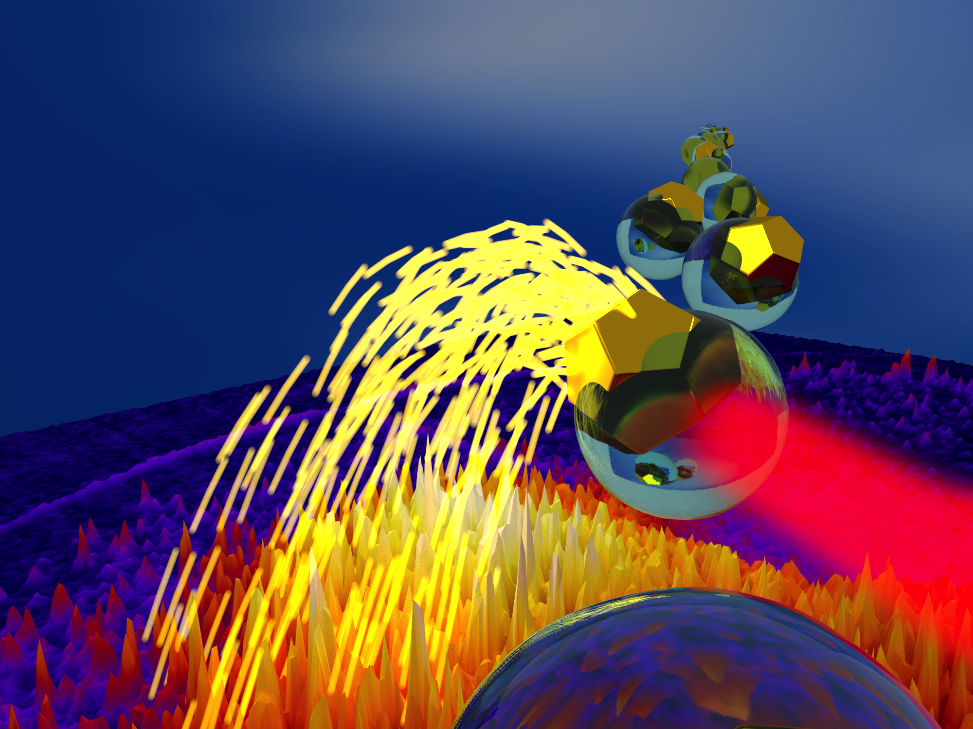

Photoelectron and photoion spectroscopy of atoms, nanoparticles, and nanoplasmas irradiated with strong femtosecond laser pulses
PhD Thesis
Daniel D. Hickstein
Kapteyn–Murnane Group
JILA – University of Colorado
Notes:
Good afternoon, and thank you all for coming to my talk. My name is Daniel Hickstein and I have spent the last few years working in the Kapteyn–Murnane group here at JILA. Today, I will be presenting my thesis research, which is titled: “Photoelectron and photoion spectroscopy of atoms, nanoparticles, and nanoplasmas irradiated with strong femtosecond laser pulses.”
That is a fairly long and confusing title, but, it is actually summarized by this image shown here.

Slide 2
Photoelectron and photoion spectroscopy of atoms, nanoparticles, and nanoplasmas irradiated with strong femtosecond laser pulses
PhD Thesis
Daniel D. Hickstein
Kapteyn–Murnane Group
JILA – University of Colorado
Photoelectrons/
Photoions
Nanoparticles
Spectrometer
Femtosecond
laser
Notes:
Here is a stream of nanoparticles, and they are being hit with this femtosecond laser. The nanoparticles are ejecting electrons and ions, which are being collected by this spectrometer here, which is making a map of the momentum of the electrons or ions.
But, you are probably still asking yourself, why do we want to study any of this. Why use these “femtosecond lasers”, why study atoms, nanoparticles, and nanoplasmas. And why are you using this photoelectron spectroscopy thing.

Slide 3

Outline
Motivation
Why femtosecond lasers?
Why atoms, nanoparticles, and nanoplasmas?
Why photoelectron/photoion spectroscopy?
Studies
Atoms
Nanoparticles
Nanoplasmas
Future directions
Notes:
So, here is an outline of the talk. The first thing that I am going to do is to try to answer these questions, by providing some motivation to explain why we are interested in looking at the interaction of atoms nanoparticles and nanoplasmas with strong femtosecond laser pulses, and why we are using photoelectron spectroscopy to try to understand this.

Slide 4
Why femtosecond lasers?
What is a femtosecond laser?
1 fs = 10⁻¹⁵ s
1 fs = 0.000000000000001 seconds
Notes:
So, the first question that we need to explain is why we want to study things with femtosecond lasers. But, first, some of my friends and family are probably asking, “What is a femtosecond laser.”
Well, to a first approximation it’s a large box. Femtosecond lasers are almost always shaped like a box. And they emit a beam of light, which is typically red. But, they are not like a light bulb or a laser pointer, because they do not continuously emit light. They emit light in incredibly short little bursts.

Slide 5
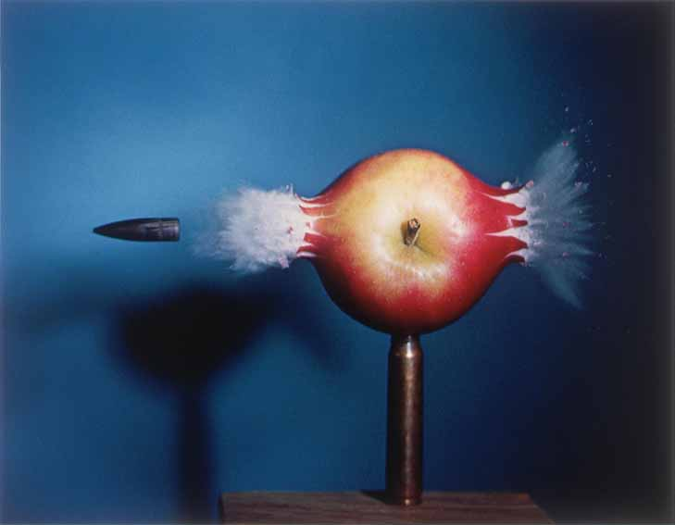
Why femtosecond lasers?
In order to measure an event in time, you need a shorter one.
Notes:
To demonstrate why fast pulses of light are interesting, I like to show this photograph. Most people have seen this photograph before, but most people do not know who took the photograph. However, in my informal survey, it seems that most Nebraskans do. For example: Dad, who took this photograph? Some people would argue that there just are not many famous people from Nebraska, but I like to believe that Nebraskans just have a special appreciation for good physics.
So, why are we interested in studying things with ultrafast laser pulses. Well, in the 1930’s, when Harold Edgerton invented the Xenon flashlamp, people were probably wondering the same thing. But, by the 1960’s, Edgerton had demonstrated that the microsecond duration bursts of light allowed him to take photographs of processes that could never hope to be seen with the naked eye, like this rifle bullet speeding through an apple.
The general rule, is that in order to measure an event in time, you need a shorter one. So, we have pulses of light that are about 100 million times faster than a xenon flashlamp,
but what processes are 100 million times faster than a flashlamp?

Slide 6



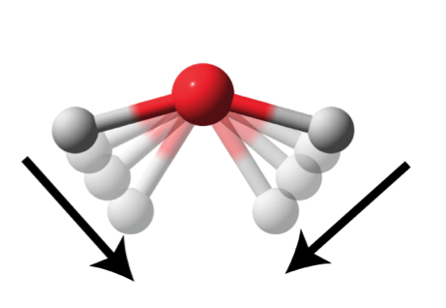
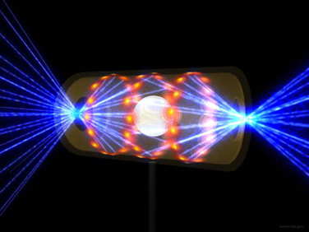
Timescales
Electron motion:
Valence (10–100s of as)
Core (few as)
Nuclear motions:
fission and fusion
(zs)
Time for neuron
to fire (1 ms)
CPU clock cycle
(~300 ps)
Bond vibrations
(~50 fs)
Camera flash
(10 μs)
Ti:sapphire lasers
(25 fs)
Shortest pulse
(67 as)
10⁻³
10⁻⁶
10⁻⁹
10⁻¹²
10⁻¹⁵
10⁻¹⁸
10⁻²¹
millisecond
nanosecond
femtosecond
zeptosecond
microsecond
picosecond
attosecond
Optics Letters, Vol. 37, Issue 18, pp. 3891-3893 (2012) http://dx.doi.org/10.1364/OL.37.003891
Notes:
Well, actually a lot of things.
Here is bullet through apple. This is actually a good bit faster than a neuron can fire, so it’s already impressive. The time that it takes for a CPU to add two numbers together, called a clock cycle, is about 300 ps these days. Bond vibrations are happening on the timescale of about 50 fs. So this is why femtosecond pulses can be used to study chemical reactions in real-time.
At the attosecond timescale, atomic motions are frozen out, but electrons are moving around. The valence elections are moving on a timescale of about 10–100 attoseconds, and the core electrons are moving on the timescale of about 1 to 10 as.
On the zeptosecond timescale, you’ve got motions inside the nucleus, for example, making an breaking a nucleus, also known as nuclear fission and nuclear fusion. Here I’m showing a picture of the tiny capsule at the National Ignition Facility in Livermore California where they focus 192 different lasers in the attempt of starting a fusion reaction. If you want an example of a fusion that actually works and doesn’t cost 1 billion dollars, here is a photograph of the sun.
Currently, the world’s shortest laser pulse is 67 attoseconds, putting it firmly in the regime of studying the motions of electrons in atoms and on the nanoscale. These pulses are difficult to make, so I’ve also included femtosecond lasers on this line, which clock in at about 25 femtoseconds.

Slide 7

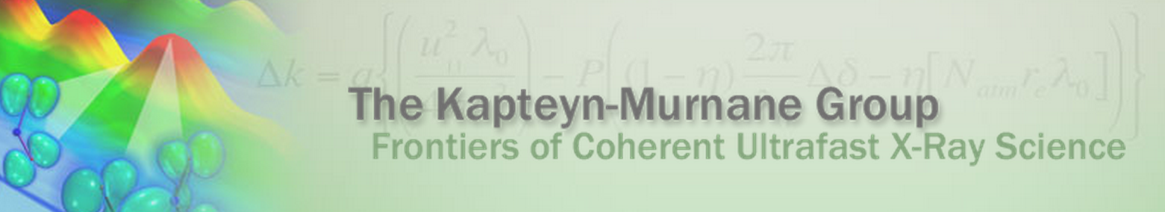

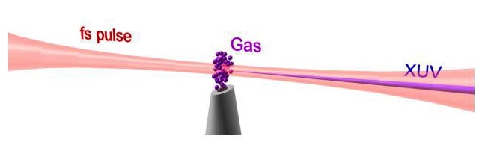
Ultrafast light sources
Ar, Ne, He, etc.
Ti:sapphire lasers
25 fs pulses of near-infrared (800 nm)
High harmonic generation
~300 as pulses of extreme ultraviolet (XUV)
Notes:
I put both attosecond laser pulses and titanium sapphire lasers on the previous slide, because these are both the specialties of the people that I work for, Margaret and Henry. Margaret and Henry actually do two things, then run a 25 person company about 3 miles from here, called KMLabs, that sells some of the best Ti:sapphire lasers in the world, and they run a 25 person research group here at JILA that focuses these femtosecond laser pulses through different gases like argon or neon or helium and converts them into attosecond duration bursts of extreme ultraviolet photons. If that seems insane to you that you can focus a infrared laser through a region of gas and create ultraviolet light, you are right, it is pretty crazy. But I will explain that in a few slides.

Slide 8
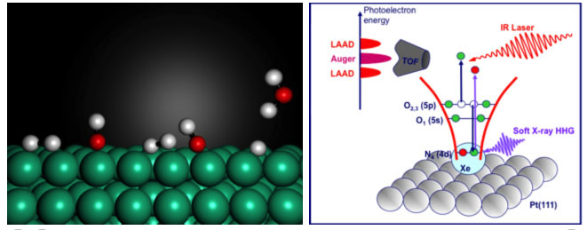
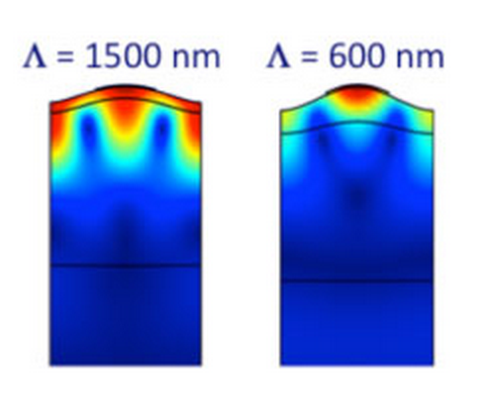
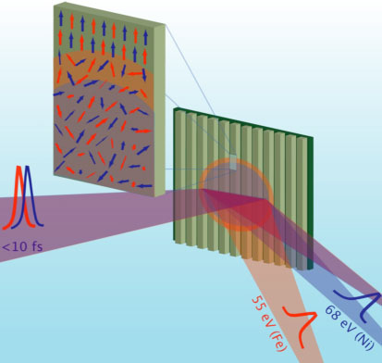
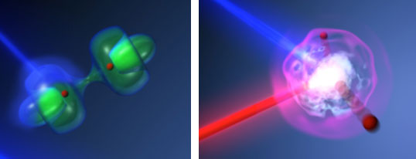
Ultrafast science in the KM Group
Ultrafast nanoscale
heat transport
Ultrafast surface science
High harmonic generation
Ultrafast molecular dynamics
Ultrafast magnetic dynamics
Femtosecond lasers
Notes:
So, using both femtosecond lasers and the attosecond pulses obtained from HHG, the KM group here at JILA can study a wide assortment of the fastest processes that we can currently study. From studying dynamics at surfaces, to watching chemical reactions unfold, to looking at both heat transport and magnetic dynamics on a nanoscale, topics that have direct applications to constructing the next generations of CPUs and hard drives.
So, we use femtosecond and attosecond laser pulses because they allow us to explore a frontier of science: studying the fastest processes possible.

Slide 9
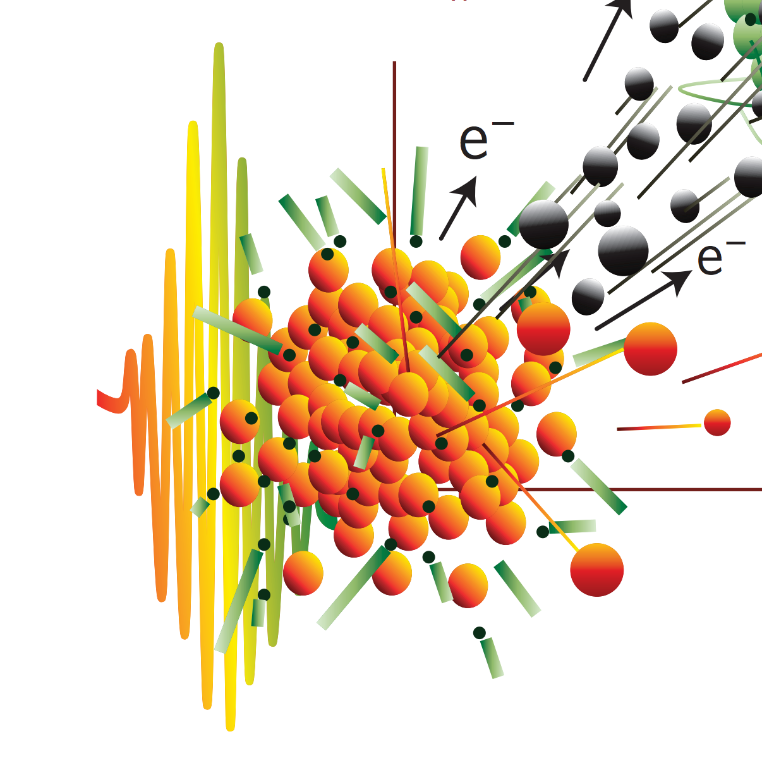
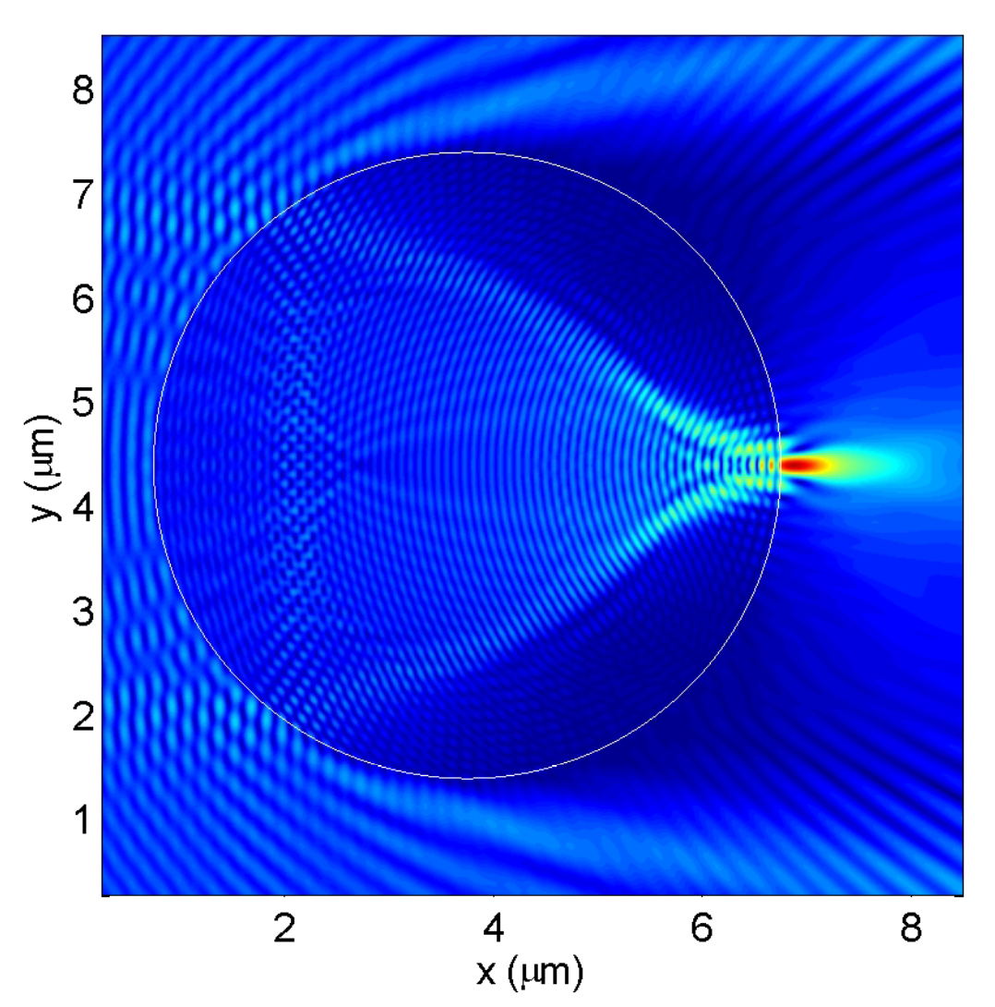
Why:
Atoms?
Nanoparticles?
Nanoplasmas?
Z. Chen, A. Taflove, and V. Backman, Opt. Express 12, 1214 (2004).
R. Rajeev, et al. Nature Phys. 9, 185, (2013).
Notes:
Why do we want to study atoms, nanoparticles, and nanoplasmas in strong femtosecond laser fields? The answer is a little bit different for each species. For atoms, one big motivation to study their behavior in strong fields is this process of high harmonic generation. It is possible that if we learn more about what happens when atoms are exposed to a strong laser field, then we will be able to make the process of high harmonic generation more efficient and more useful.
We are interested in nanoparticles, because nanoparticles offer a way to enhance the light field on a nanometer scale. Normally, using lenses, you cannot focus light to dimensions smaller than the wavelength of the light. Which is annoying. However, with nanoparticles, light can be focused on a much more localized scale.
For nanoplasmas, the motivation is that they are highly absorbing of laser light. In addition, they keep the energy that they absorb localized in a very small region. The net result is that nanoplasmas can reach very high temperatures in a strong laser field and eject high energy electrons, ions, and photons. This could mean that nanoplasmas could be a valuable source for a range of applications that require high energy particles, such as modern cancer therapies.

Slide 10
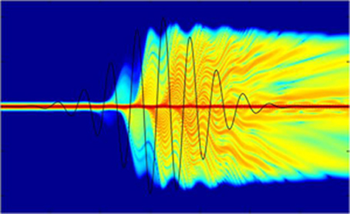
Why photoelectron/ photoion spectroscopy?
Why look at the momentum of electrons and ions produced by the laser–matter interaction?
Understand electron dynamics
Observe individual
nanoparticles/nanoplasmas
http://www.orc.soton.ac.uk/xray.html
Notes:
The last part of the introduction is to answer the question of why we wanted to use a photoelectron and photoion spectroscopy to study these systems.
In the case of studying atoms, we wanted to use photoelectron spectroscopy, because it is field driven electrons that are responsible for this process of high-harmonic generation, and so if we can understand the motions of the electrons, we can gain insight into the high-harmonic generation process.
In the case of nanoparticles and nanoplasmas, we used photoion spectroscopy because it gave us the unusual ability to clearly observe individual nanoparticles and nanoplasmas. Typically, experiments are conducted on many nanoparticles or nanoplasmas at once, but our experiments have the ability to probe a single nanoparticle or nanoplasma at a time.

Slide 11
Outline
Motivation
Why femtosecond lasers?
Why atoms, nanoparticles, and nanoplasmas?
Why photoelectron/photoion spectroscopy?
Studies
Atoms
Nanoparticles
Nanoplasmas
Future directions
Notes:
So, now we move on to the studies, first one about strong-field ionization of atomic xenon. The next about understand the localized laser ablation of nanoparticles. The third is about making the first observation of shock waves in nanoscale plasmas.

Slide 12
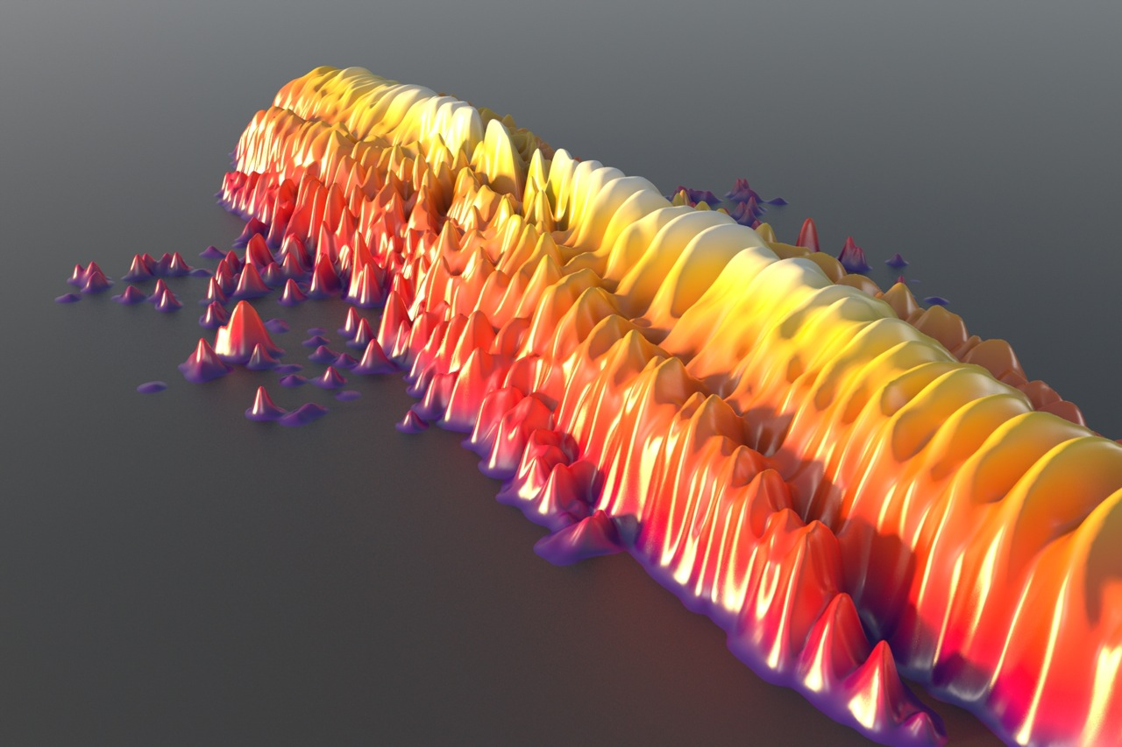
Study 1 - Atoms Electron dynamics in strong fields
D. D. Hickstein, P. Ranitovic, S. Witte, X.-M. Tong, Y. Huismans, P. Arpin, X. Zhou, K. E. Keister, C. Hogle, B. Zhang, C. Ding, P. Johnsson, N. Toshima, M. J. J. Vrakking, M. M. Murnane, and H. C. Kapteyn, “Direct Visualization of Laser-Driven Electron Multiple Scattering and Tunneling Distance in Strong-Field Ionization“
Phys. Rev. Lett. 109, 073004 (2012).
Notes:
So this is study number 1, where we look at atoms. It is based on a 2012 article published in Physical Review Letters. Specifically, we want to look at the dynamics of electrons that are ripped from these atoms by a strong laser field and shaken around in the continuum. As you can see from this illustration of the simulations results, this produces some very complicated and beautiful structures in the photoelectron distributions.

Slide 13
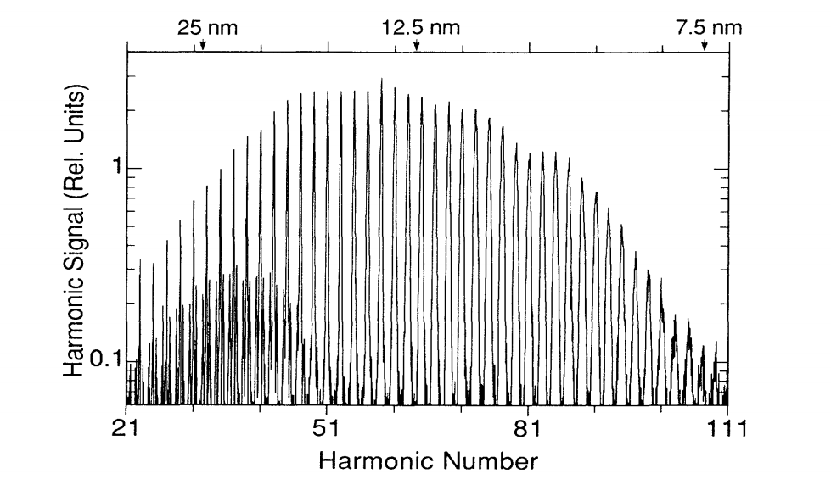
Motivation: HHG (High Harmonic Generation)
Infrared photons
Extreme Ultraviolet (EUV) Photon
Notes:
So, as I mentioned before, we are interested in studying atoms in strong laser fields, because the process of high harmonic generation takes place in atomic gases exposed to strong laser fields. So, let’s talk a little bit about high-harmonic generation. The spectrum of the light that is generated by the HHG process looks like a series of peaks, with the spacing between the peaks being given by two times the photon energy of the driving laser.
So, the process corresponds to the conversion of many infrared photons from the driving laser to create each high energy photon of extreme ultraviolet or soft x-ray light. And this seems really crazy, because in nature, you never really absorb more than one photon at a time. In contrast, our group regularly observes the absorption of dozens of photons and our record is something like 4000. And one way to think about this, is that with a traditional light sources, the photons are very spread out, and you would never find more than one photon near an atom at a given time.
When you have a femtosecond pulse, you have taken those photons and pressed them into a tiny light pancake that has an incredibly high photon density. This enables crazy things to happen, like the simultaneous absorption of 100s of photons.

Slide 14
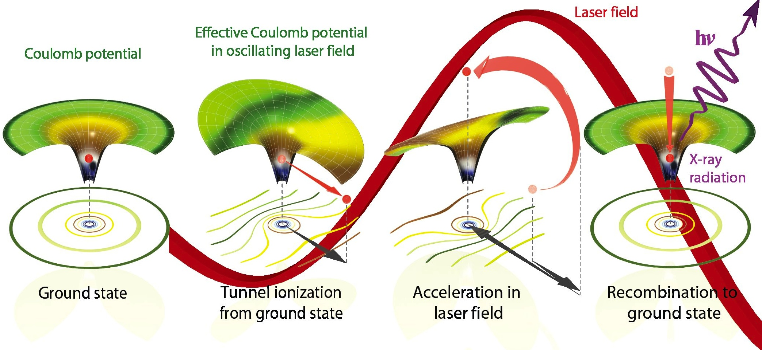
The three-step model
STEP 1 STEP 2 STEP 3
Notes:
But how does this process of high-harmonic generation actually work? The most honest answer is: “It’s complicated”. But, if you don’t mind making approximations, here is the model that we use to predict most, but not all, characteristics of high harmonic generation. It’s called the three step model. And I think that it’s almost like a fairy tale.
So, we start off with the electron, living happily in the Coulomb potential. Oh no, but what is this, the laser field is so strong that it’s distorting the Coulomb potential, leaving only a thin barrier, though which the electron can tunnel through. So the electron tunnels out and starts rolling down this hill, away from its home.
But then there is a predictable twist: the laser field changes direction, and starts the push the electron back towards the Coulomb potential, picking up speed, going faster and faster.
Finally, the electron smashes back into the atom and releases its kinetic energy in the form of a high-energy photon.

Slide 15
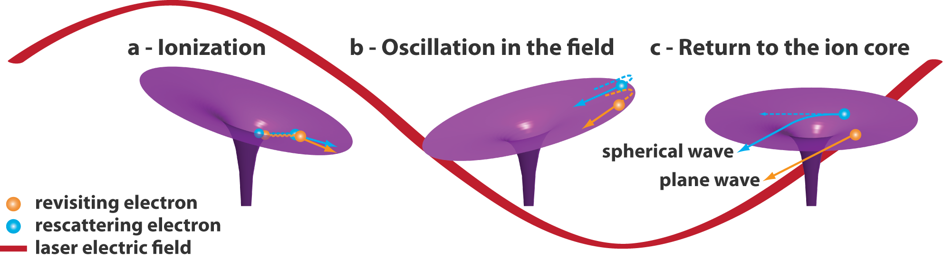
Strong-field ionization
Notes:
But, not all of the electrons that tunnel ionize will end up recombining with the ion. As I’ve shown here, the electrons can tunnel ionize, be accelerated in the laser field, and either completely miss the ion (as shown in orange) or just scatter off the ion without recombining.
This process is called strong field ionization. And, since it shares the first two steps with the HHG process, if we study strong-field ionization, this can help us to understand the process of High Harmonic generation.

Slide 16
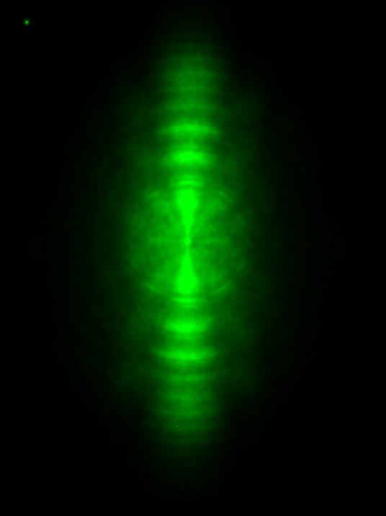
Velocity map imaging (VMI) spectroscopy
electrons/ions
Laser
atoms
(or nanoparticle)
Photoelectron momentum distribution
(+/-) Electric Field
Notes:
So, we are going to use photoelectron imaging spectroscopy to look at the strong-field ionization from atomic xenon.
What we are going to do is start with a sample of atoms (or a nanoparticle, as I will talk about later).
The the laser pulse comes and hits the sample, kicking off electrons (or ions, but in this section I will be talking about electrons). These electrons can whiz off in all directions. The spectrometer has a detector on one side. An electric field pushed the electrons (or ions, depending on the polarity of the field) towards the detector.
The result is that the detector records a 2D projection of the full 3D momentum distribution of the electrons or ions.

Slide 17
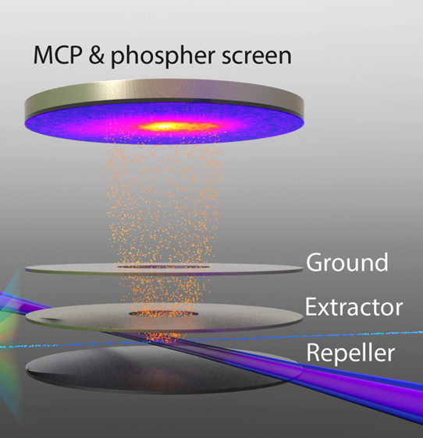
Velocity map imaging (VMI) spectroscopy
“Eppink and Parker” geometry
Notes:
Here is an illustration of what the apparatus looks like on the inside. Three electrodes are used to generate a static electric field which pushes the electrons onto the detector. And this geometry of the electrodes actually does something very special. As you can see here, the laser is fairly large, so we can create electrons throughout a large volume. This lens arrangement pushes the electrons in just such a way so that if two electrons have the same velocity, they arrive at the exact same point on the detector regardless of their initial momentum. This is why we call the device a velocity map imaging spectrometer, because it is only the velocity of the particle, not the initial position, that is mapped to the detector.

Slide 18
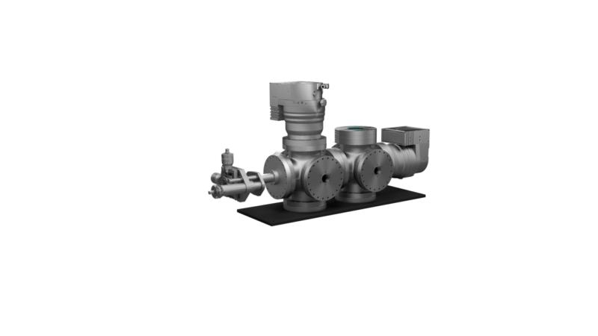
Apparatus
VMI Spectrometer
Notes:
This is what the apparatus looks like from the outside. It is about 1 meter long and consists of two differentially pumped vacuum chambers. Since this is a special occasion, let’s cut the chamber is half and see what is happening inside. As you can see, the nanoparticles emerge from the aerodynamic lens and pass into the VMI spectrometer. The laser creates a plasma from a single nanoparticle and the positive ions are pushed towards the detector.

Slide 19
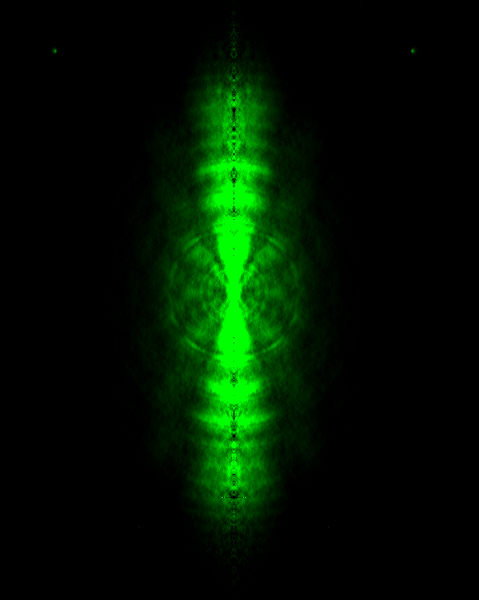
2D to 3D
2D
Slice of 3D
Math
(Abel transform)
N₂ - 800 nm
2D projection, as recorded on VMI
Abel transform with BASEX (assumes cylindrical symmetry)
Notes:
Since we are just using an electric field to squash the electrons onto the detector, we get a 2D projection of the 3D momentum distribution. This tends to blur the features that we want to look at. What we really want is the 3D momentum distribution. In most VMI experiments, the photoelectron distribution is cylindrically symmetric about the laser polarization axis. Because of this symmetry, we can use the Abel transform to obtain the 3D distribution from the 2D projection.
And this is what the photoelectron angular distributions looks like from the strong-field ionization of nitrogen at 800 nm.

Slide 20
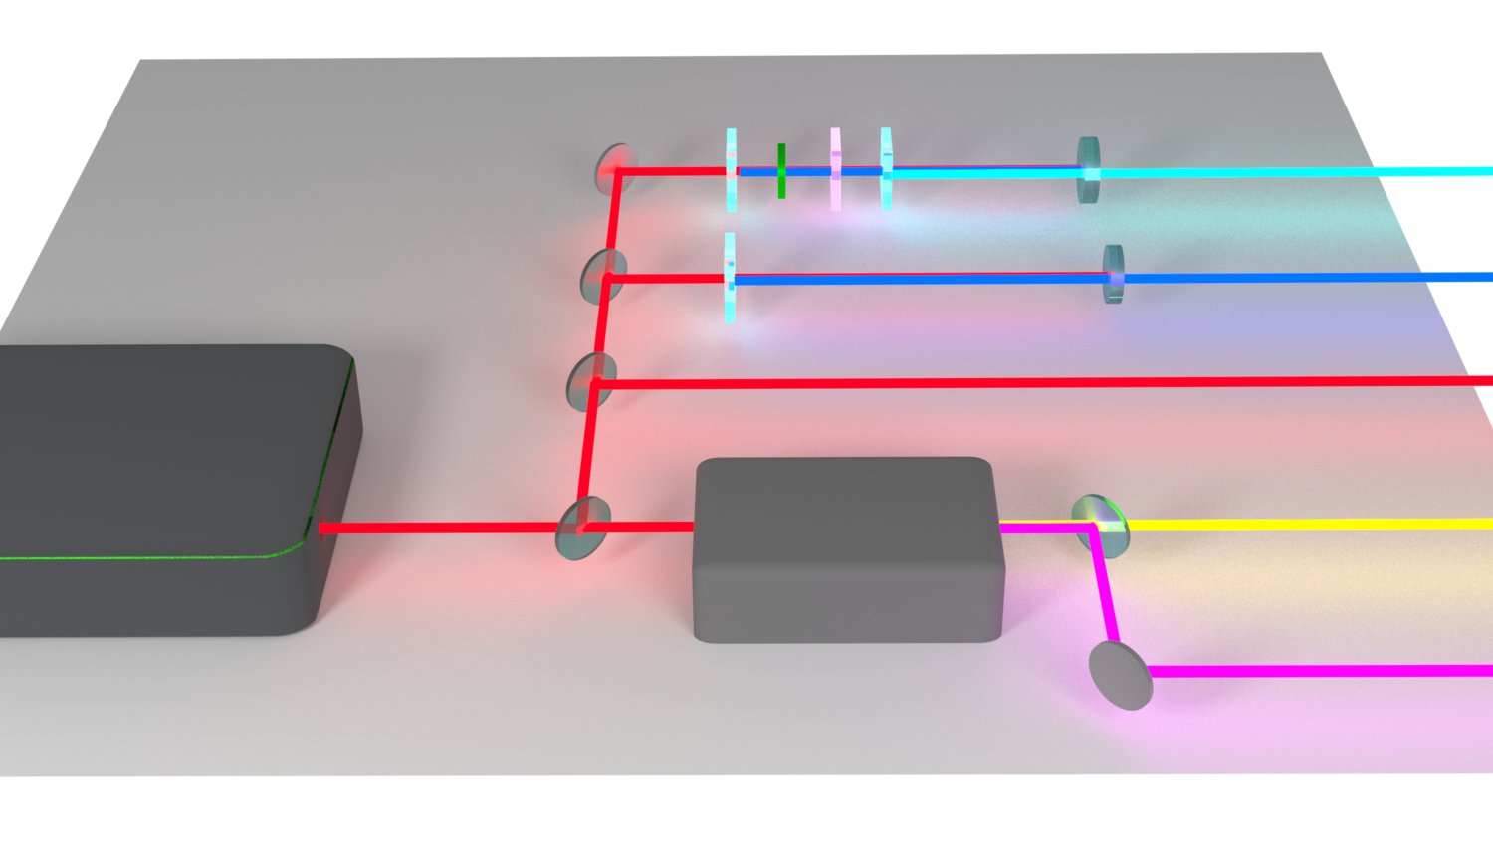
Light sources
BBO λ/2 calcite BBO
267 nm
BBO
400 nm
Ti:sapphire
laser
800 nm
OPA
1300 nm
2000 nm
Notes:
So, people have looked at the strong-field ionization from atomic gases before. What makes our experiment different from the rest is that we use a broad range of different wavelengths, which allows us to see how the physics changes as a function of wavelength. This is a knob that previous studies were not able to turn. The reason this had not been done before is that it’s reasonably difficult. We cannot just turn a knob and tune our laser across a broad range of wavelengths, we need to implement complicated frequency conversion steps using nonlinear optics. And this means that we needed to start with a fairly powerful femtosecond laser.
The 800 nm light is easy, because that is the direct output of the Ti:sapphire laser system. The second harmonic at 400 nm is also pretty easy, because all you need to do is stick a beta barium borate or BBO crystal into the beam and produce 400 nm light.
The 267 nm light is a little more difficult, because you need to produce 400 using a BBO crystal, use a half waveplate to correct the polarization, a calcite plate to set the appropriate time delay, and then generate the third harmonic in a second BBO crystal through sum frequency generation.
The 1300 and 2000 nm wavelengths are the most difficult to generate. To make these, we use a three-stage optical parametric amplifier. As far as I am concerned, this is just a black box that magically makes mid-infrared wavelengths, but if you are interested in how it works, Tingting can tell you all about it.

Slide 21
Experimental photoelectron distributions
Keldysh
Parameter:
3
2
1
0.6
0.4
Notes:
So, here is what the photoelectron spectra look like under strong-field ionization using these different driving laser wavelengths. One of the first things that we notice are that some of these spectra have very sharp rings. These first ring corresponds to enough photons to give the electron enough energy to overcome the ionization potential of the atom. The outer rings correspond to the absorption of photons over the ionization potential. This process is called above-threshold ionization.
As we make the wavelength longer, we notice that the rings disappear, and the electron distribution becomes more elongated. And this is due to the fact that on the left, we have a high keldysh parameter, which means that we are will into the multiphoton regime, while on the right we have a low keldysh parameter, indicating that we are in the tunneling regime.
The other interesting things that we see are these pronounced side-lobe structures for the 800, 1300 and 2000 nm spectra.

Slide 22
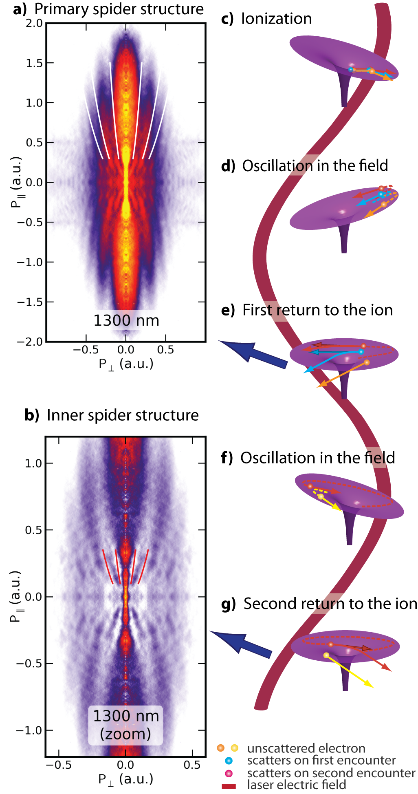
Notes:
We called these the “spider structures” because they reminded us of the body and legs of a spider. If we look closely, we also see that there are these smaller structures that occur at very low energies. We called these the inner spider structures, and these had never been observed before.
So, let me skip ahead a little bit and tell you what is causing these structures, and then I’ll explain how we figured this out.
This figure is a little bit complicated, but the idea here is really simple. The electrons are tunnel ionized by the laser field and propagate in the laser field just like in HHG. Then, just like in HHG, the electrons are driven back to the ion by the laser field. At this point, the electron wavepacket from scatter from the ion. Just like a ocean wave hitting a rock, the scattered wave interferes with the unscattered wave and generates interference patterns. In this case, the interference patterns give rise to the spider structure.
But the story does not end there. The electron wavepacket continues to be driven by the laser field, and after the first time that it visits the ion, it returns, and it has more opportunities to rescatter from the ion. The inner spider structure corresponds to the portion of the electron wavepacket that scatters on subsequent revisits to the ion.

Slide 23
Plane–spherical wave model
Notes:
So, why are we so confident that the main spider structures are due to the scattering of the electron wavepacket by the ion, and that the inner spider structures correspond to higher-order scattering of the electron wavepacket with the ion? We have confidence in this explanation, because we can construct a very simple model that simulates the shape and spacing of the spider structures almost exactly for the longer wavelength driving lasers.
This model is the plane–spherical wave model, and it’s called that because all we do is add together two wavepackets, one with phase that increases with the direction parallel to the laser polarization, and the other with phase that increases radially with increasing momentum. With this model, we can generate interference structures that look very much like the spider structures. Here I have overlayed the minima of the spider structure, as predicted by a calculation with the plane-spherical wave model on the actual data, and, as you can see, the shape is a very good fit.
The spacing of the spider structure calculated using the plane-spherical wave model depends on the frequency of the plane and spherical waves. And you might think that I just picked this frequency so that I would get a good agreement with the experimental data. But this is not the case! The frequency of the the plane and spherical waves can be calculated from first principles, given the intensity and wavelength of the laser.

Slide 24
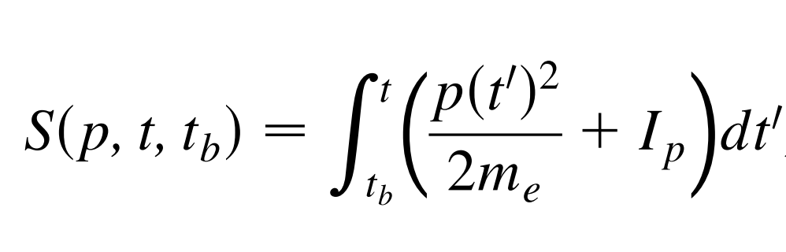
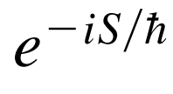
Applying the model
Notes:
The way that we calculate the frequency of the plane and the spherical waves is simply by thinking about the trajectories that the electrons take as they are driven by the strong laser field. Here I plot a few of these trajectories, showing how some of the electrons may be driven past the ion many times. In path integral quantum mechanics, we can just add together many different paths as long as we include the phase of each path. That phase is given by e to the minus S/hbar, where S is the action. The find the action, you just integrate the kinetic energy plus the ionization potential of the atom from the time that the electron tunnels into the continuum to the time that the electron returns to the ion. It might sound a little complicated, but you just tell the computer what to do and it gives you the answer instantaneously.
Using this approach, we can plot the action (which is just the phase) as a function of momentum. The slope of this graph tells us what frequency to use for the plane and spherical waves. When we use this frequency, we can get pretty good agreement between the model and the experimental data for long driving laser wavelengths.

Slide 25
Plane-spherical wave model
Notes:
As you can see here, we can use this very simple plane-spherical wave model to simulate what the electron distributions should look like at these different wavelengths and intensities. I have drawn the minima on the lower graph, and you can see that they match up really well with the data with the three longest wavelengths.

Slide 26
Multiple rescattering
Notes:
If we look again at this graph of the phase versus the final momentum of the electron, we see that there are these big jumps here. And this is due to regions where the electron encounters the ion multiple times. In these regions I made the approximation that the electron would scatter from the ion at the laser revisit, and so you can see that the slope of the phase is different than it is at higher final momenta.
We can include these steps into the plane-spherical wave model and generate something that looks like the inner spider structures. If we compare the frequencies predicted by the plane-spherical wave model with the experimental data, we see that they are in very good agreement. This agreement means that we are probably correct in assigning the main spider structures to the electron scattering from the ion on the first revisit and the inner spider structures as resulting from rescattering on subsequent revisits.

Slide 27
Multiple rescattering cutoffs
Notes:
One thing that we can see very clearly in the data, is that there are distinct cutoff energies where the inner spider structures end. These cutoffs can also be calculated pretty easily from our model.

Slide 28
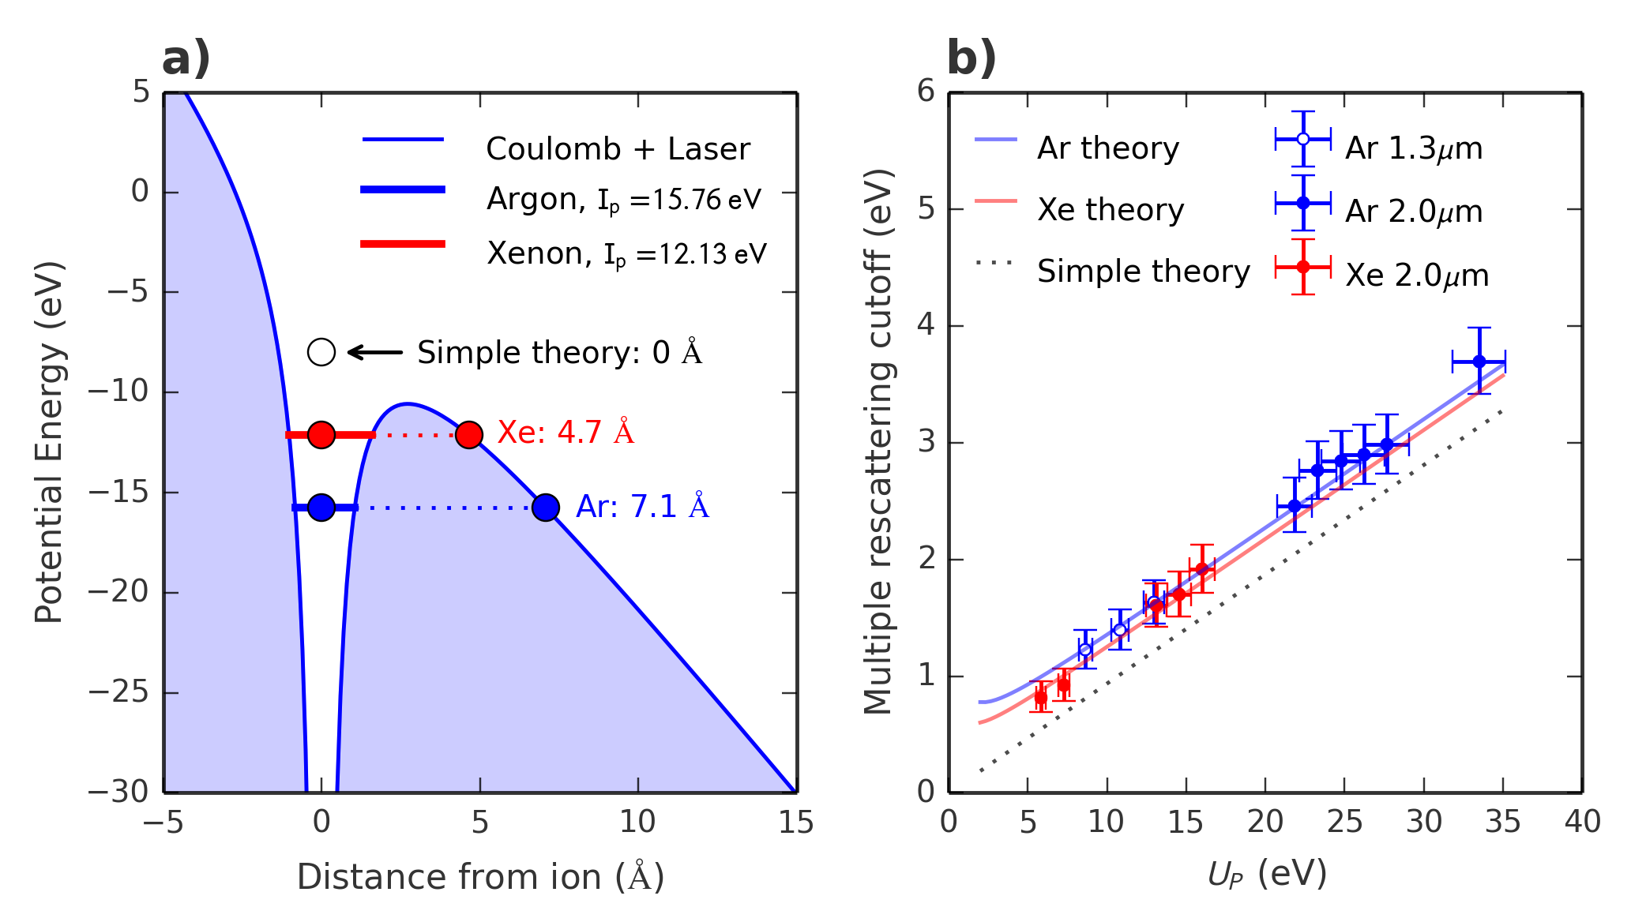
Quantum tunnel distance
Notes:
But, when we compare the experimental cutoffs (given by these dots with error bars) to what is predicted by our model (shown as a dotted black line), then we see that there is a problem, they don’t line up!
However, our model forgot about something, we did not take into consideration the fact that when the electron tunnels from the atom, it emerges at a small distance from the atom. Here is a sketch of that process. As you can see, the real tunneling distance is only a few angstrom. But, when we take that small tunneling distance into consideration in the model, we find that we actually have very good agreement with the experimentally observed cutoffs.
As far as we know, this is perhaps the only observation of the tunneling distance that takes place when atoms experience a strong laser field.

Slide 29
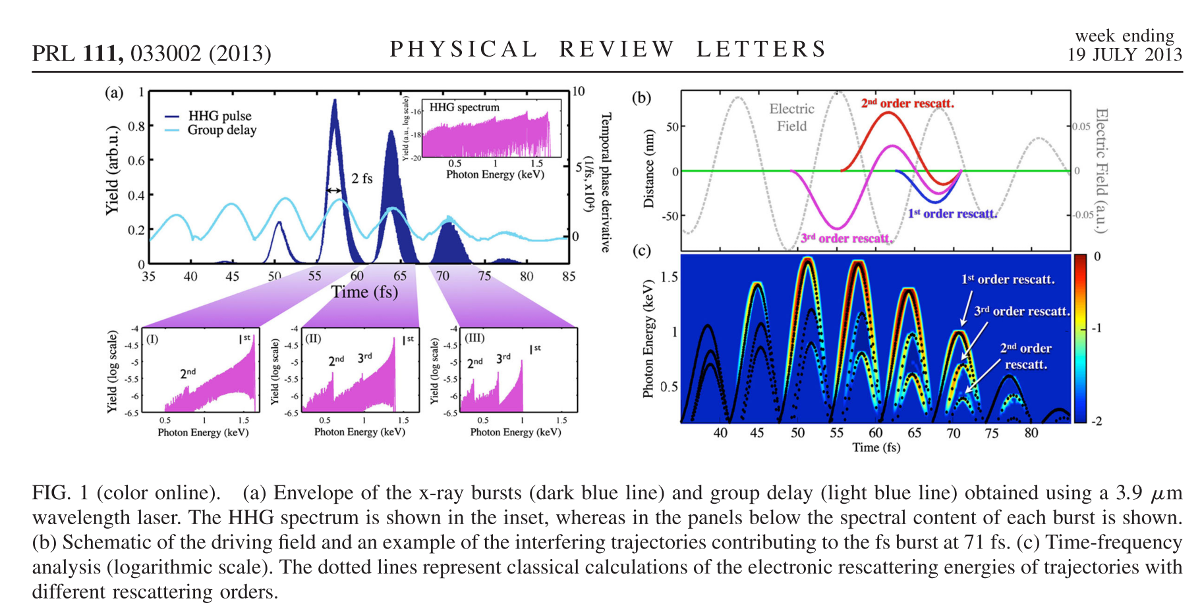
Zeptosecond pulses
Notes:
So, when we first made and published this study, I thought that it was interesting, but I thought that there was really a zero percent chance that the rest of the world would ever really care about the fact that an electric field could wiggle atoms past a xenon atoms multiple times. That seems like a really small detail. However, a more recent paper written by Carlos from Andreas Becker’s group presented theoretical calculations demonstrating how multiple rescattering could enable the generation of pulses with zeptosecond structure. So, it’s possible that this technique could be used to set a new record for the world’s shortest laser pulses.

Slide 30
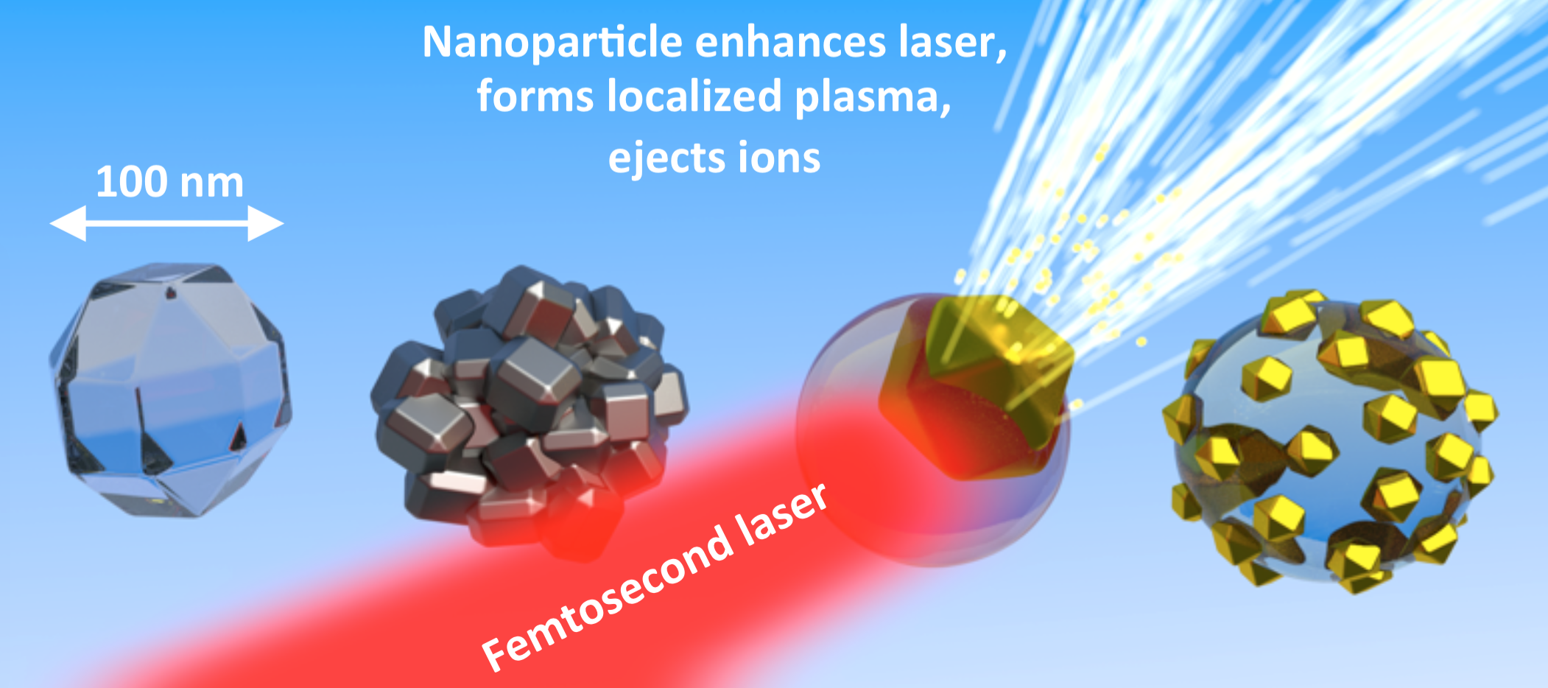
Study 2 - Nanoparticles Observing localized light absorption
D. D. Hickstein, F. Dollar, J. L. Ellis, K. J. Schnitzenbaumer, K. E. Keister, G. M. Petrov, C. Ding, B. B. Palm, J. A Gaffney, M. E. Foord, S. B. Libby, G. Dukovic, J. L. Jimenez, H. C. Kapteyn, M. M. Murnane, and W. Xiong, “Mapping Nanoscale Absorption of Femtosecond Laser Pulses Using Plasma Explosion Imaging.”
ACS Nano 8, 8810 (2014).
Notes:
Now I will move on to the second part of this talk, about how we can use the plasma formation process to understand how nanoparticles absorb intense, femtosecond laser pulses. The basic idea is that the laser field is enhanced in a specific region, and a plasma is created only in this region of the nanoparticle. This plasma ejects ions in a specific direction, and this direction corresponds to the location of the plasma within the nanoparticle.

Slide 31

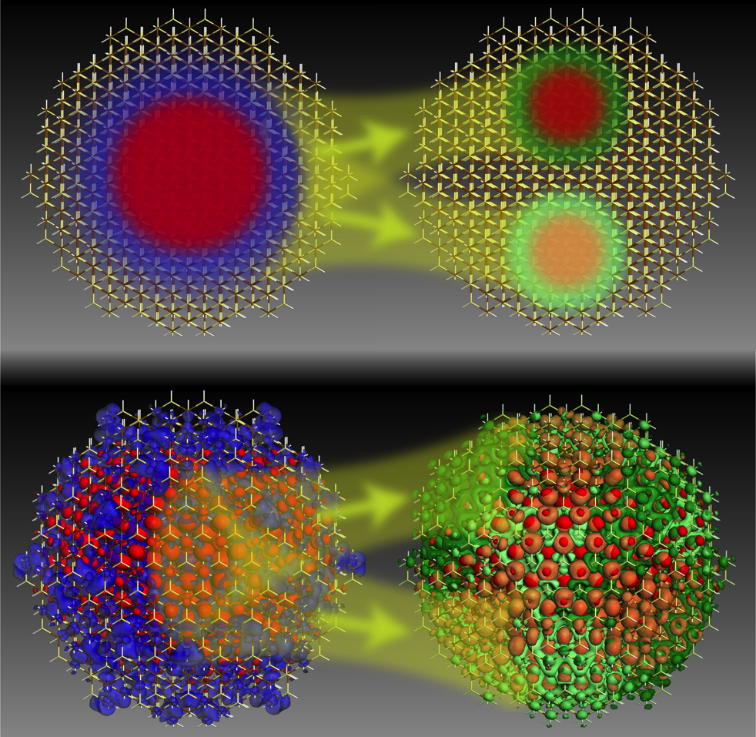
Nanoparticles in the VMI
Mark Lusk, Colorado School of Mines
Electronic structure of
quantum dots (semiconductor nanocrystals)
Velocity Map Imaging Spectroscopy (VMI)
Notes:
So how did we get involved in this difficult and very messy business of putting nanoparticles into our VMI spectrometer?
Here I’m showing two journal covers. This cover on the left is from the Zewail group and is a nice demonstration of how VMI images like these can provide beautifully detailed information about the electronic structure of a molecule in the gas phase. With these cartoons, they are showing how the experimental images at various time delays can be stitched together to provide a femtosecond movie of a chemical reaction.
On the right I’m showing an ACS nano cover from the Lusk group that shows a calculation of excitonic wavefunctions in quantum dots. Our overarching goal is to use velocity map imaging to try to detained images and movies of nanomaterials just like it has done for atoms and molecules in the gas phase.

Slide 32
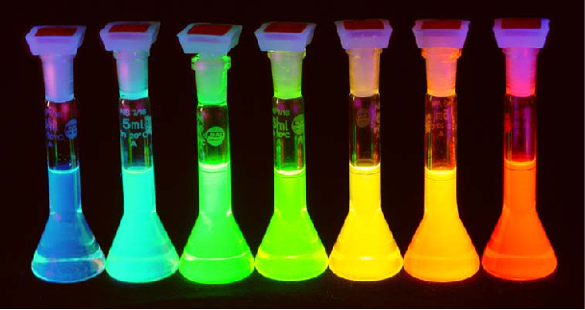


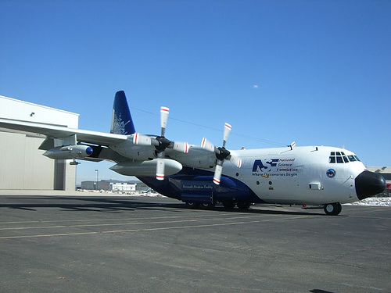
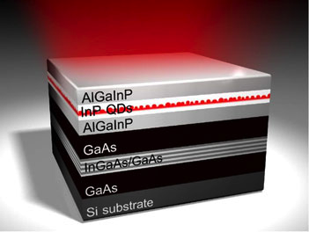
Nanoparticles in vacuum
University of Colorado Chemistry Department
Brett Palm
Jose Jimenez
Notes:
As most of you know, nanoparticles are typically found imbedded in bulk material, attached to a surface, or, most commonly, swimming in a large container of solvent. This is not ideal, because whenever you study them when they are in close proximity to something else, it’s never clear if you are studying the fundamantal properties of the nanoparticles, or if you are studying the interaction of the nanoparticles with the solvent. Also, if the particles are stuck in a jug of solvent or buried in a brick of material, we cannot use photoelectron or photoion spectroscopy.
So, how did we go about getting them into our ultrahigh vacuum chamber? Well, we were lucky enough to be located just down the block from the Jose Jimenez group at the University of Colorado Chemistry Department. Jose and his lab spend their time flying around in airplanes sucking atmospheric dust into their mass spectrometers. So, these people are truly professionals at getting nanoparticles into vacuum chambers. They were nice enough to show us the equipment that they use and how it works. So, as soon as their back was turned, we “borrowed” that equipment and attached it to our spectrometer.

Slide 33
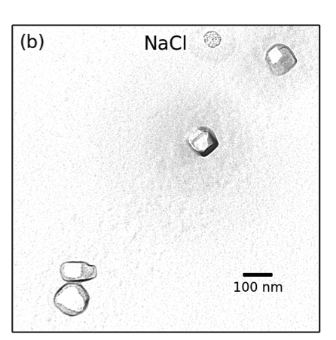
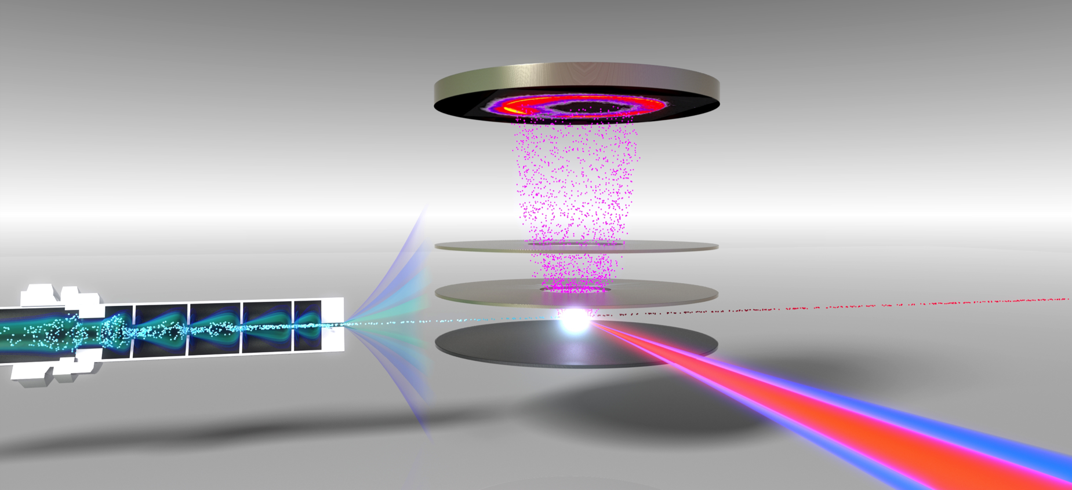
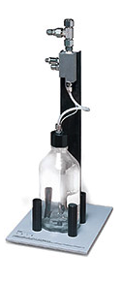
Experiment
VMI spectrometer + aerodynamic lens
Detector
Positive ions
Aerodynamic lens
VMI Electrodes
400 nm and 800 nm
laser pulses
(40 fs, 1 kHz)
Nanoparticle beam
Plasma explosion from single nanoparticle
atomizer
Notes:
So, this figure shows our VMI spectrometer, which we have modified by attaching a nanoparticle source. The source consists of a compressed gas atomizer and an aerodynamic lens. We start with 1 liter bottle containing either colloidal nanoparticles or simply a salt solution. The atomizer produces a fine mist of 1 micron droplets which evaporate to leave behind nanoparticles with diameters of about 100 nm. These particles consist of either aggregates of nanoparticles or single crystals of salt. The nanoparticle aerosol then passes through the aerodynamic lens, which forms a collimated beam of nanoparticles while leaving the gas divergent. The nanoparticle beam is then crossed with a femtosecond laser operating at 1 kHz. The positive ions that are released are collected by a velocity-map-imaging spectrometer.
The most interesting part of this experiment is that we can control the number of nanoparticles in the interaction region simply by changing the spot size of the laser. In the experiments that I will talk about today, we use a very small laser which allows us to probe single nanoparticles.

Slide 34
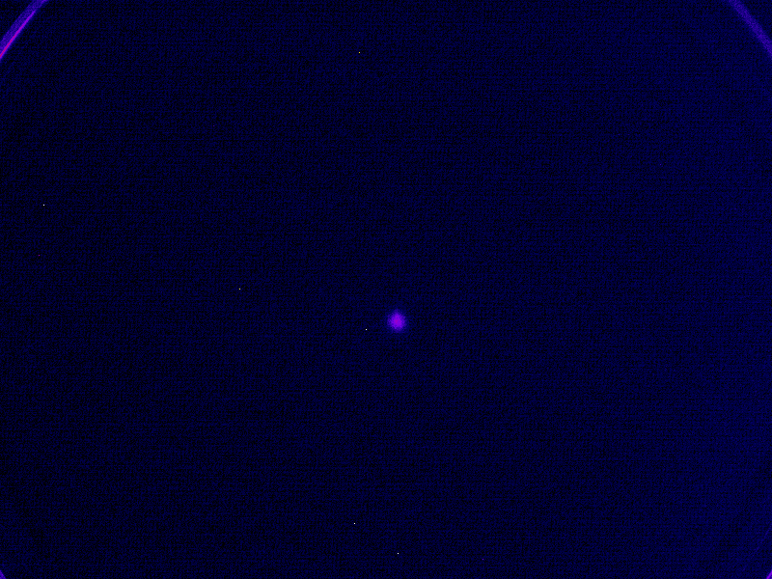
Ion distributions of single nanoparticles
Display asymmetry
Laser polarization
Laser propagation
Notes:
We were originally trying to just ionize a few electrons from the nanoparticles, but, we accidentally had the laser tuned up way too high, and here is what we saw.
Here is a slightly more colorful view of what the raw data looks like on the detector. You can see sudden flashes that contain on the order of 10,000 or more ions. These flashes correspond to the conversion of a nanoparticle into a nanoplasma, which rapidly expands and showers the detector with positive ions.
You will notice that there is a lot of variability of the photoion yield and the shape of the photoion angular distribution. This is due to two reasons: First, the nanoparticles can sample a wide range of intensities in the laser focus. And Second, the nanoparticles have a distribution of shapes and sizes and this influences the photoion distribution, as I will cover in the second part of this talk.

Slide 35
Asymmetry in ion distributions
Depends on laser intensity
Notes:
This asymmetry depends on the intensity of the laser. When the laser intensity is high, we see ion momentum distributions that are more-or-less symmetric about zero kinetic energy and correspond to the creation of a plasma in the entire nanoparticle. However, when we use lower laser intensities, we see ion distributions that are highly asymmetric and correspond to the formation of a localized plasma in a small region of the nanoparticle.

Slide 36
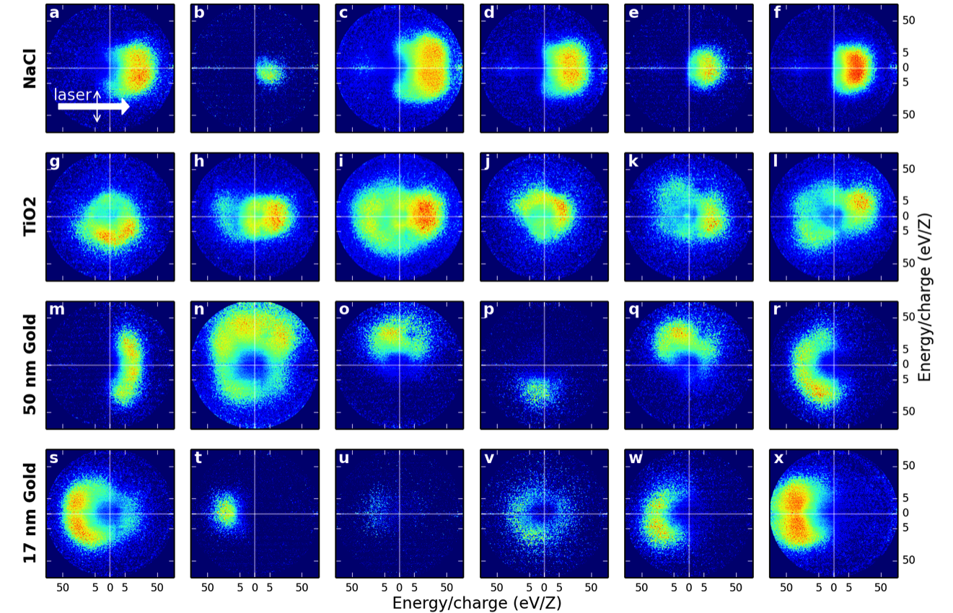
Asymmetric ion distributions
Depends on sample composition
Notes:
We also noticed that the asymmetry of the ion distribution depends on which nanoparticle sample that we use.
a) As you can see, the NaCl sample ejects ions in the direction of laser propagation. This is very unusual for VMI, because the angular distributions are almost always cylindrically symmetric about the laser polarization direction.
b) The TiO2 ejects ions symmetrically about zero kinetic energy. c) 50 nm gold nanoparticles shoot ions in seemingly random directions: up, down, left, right, wherever! D) The 17 nm sample ejects ions back towards the source of the radiation.
But what is causing these different behaviors?

Slide 37
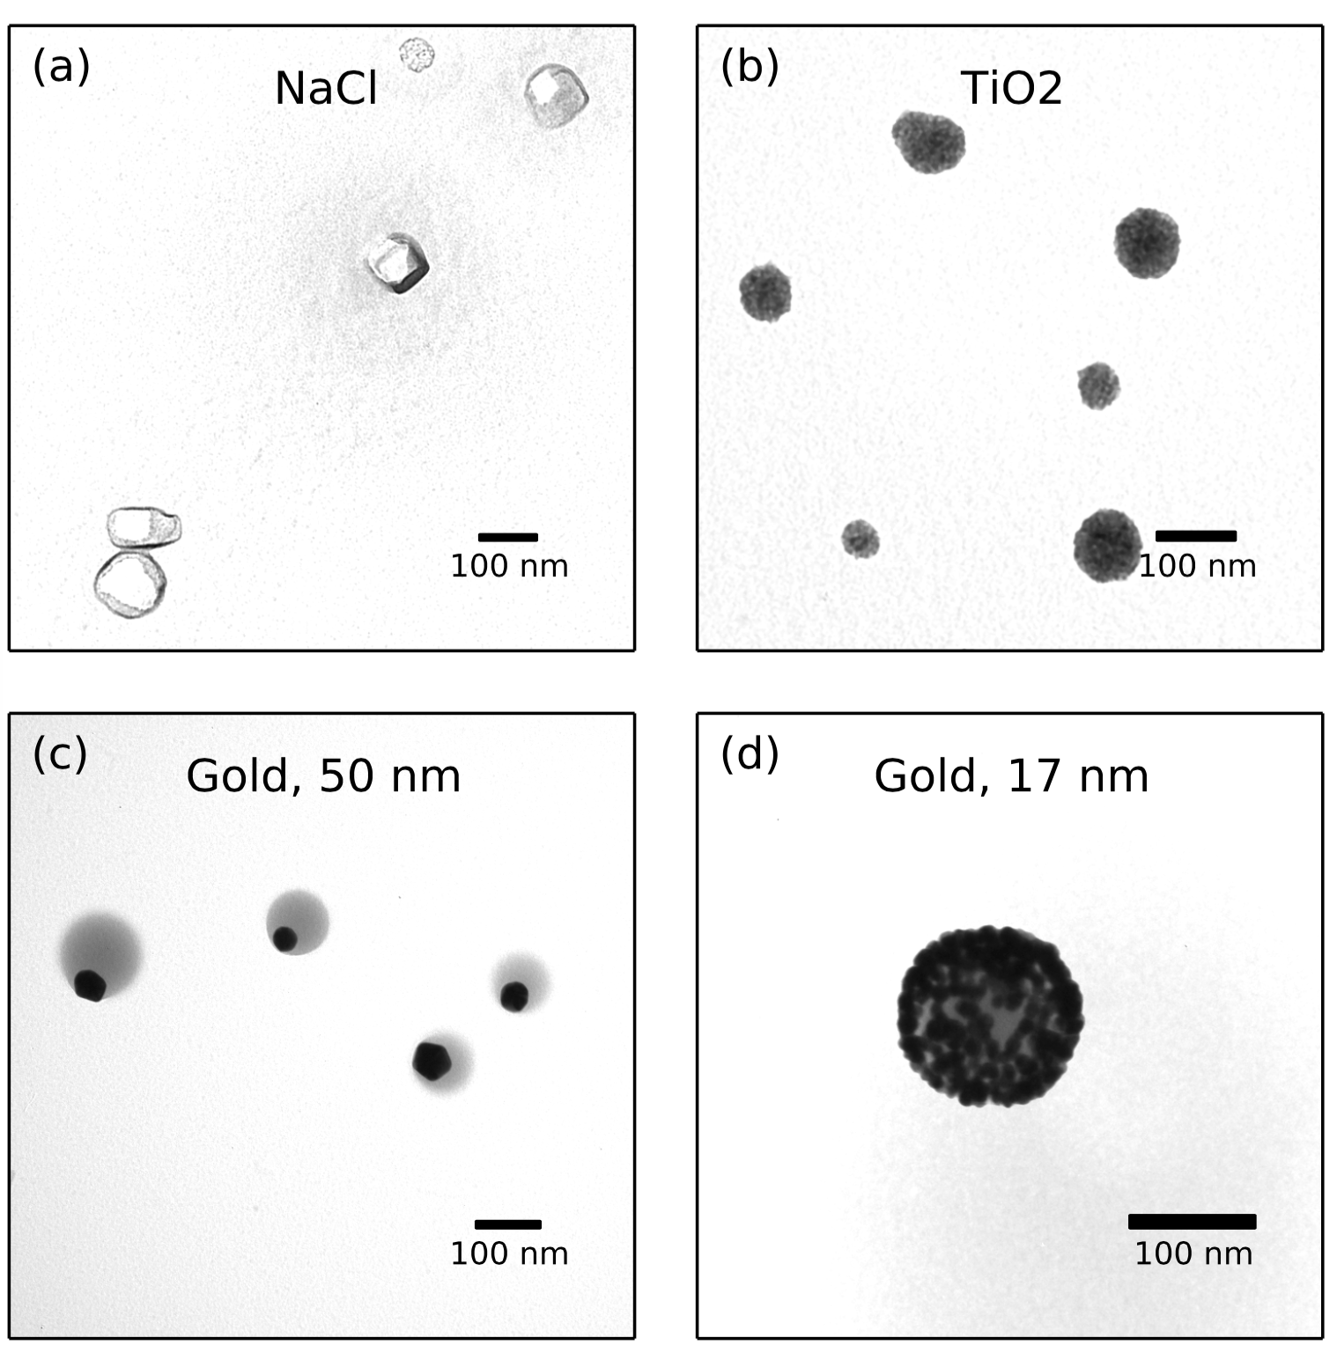
Electron microscopy
Reveals particle morphology
Notes:
The key to figuring out this sample dependence was to place TEM grids inside of the vacuum chamber and collect nanoparticles as they fly through the experiment. Then we can perform electron microscopy and see what are particles actually look like. A) A sodium chloride solution produces 100 nm particles that appear to be single crystals. B) the TiO2 solution produces aggregates of 5 nm TiO2 particles. C) The 50 nm gold sample produces very weird looking “nano eyeballs” that feature a gold nanoparticle, shown here in black, embedded in a sphere of lower density material. The lower density material is an organic polymer that that manufacturer of the nanoparticles puts in the solution to keep the particles from aggregating, and here it has the unexpected but convenient effect of allowing us to produce asymmetric nanoparticles. D) the 17 nm gold nanoparticle sample is also composed of a large sphere of ligand polymer material, but in this case, we have many small gold nanospheres per aggregate.

Slide 38
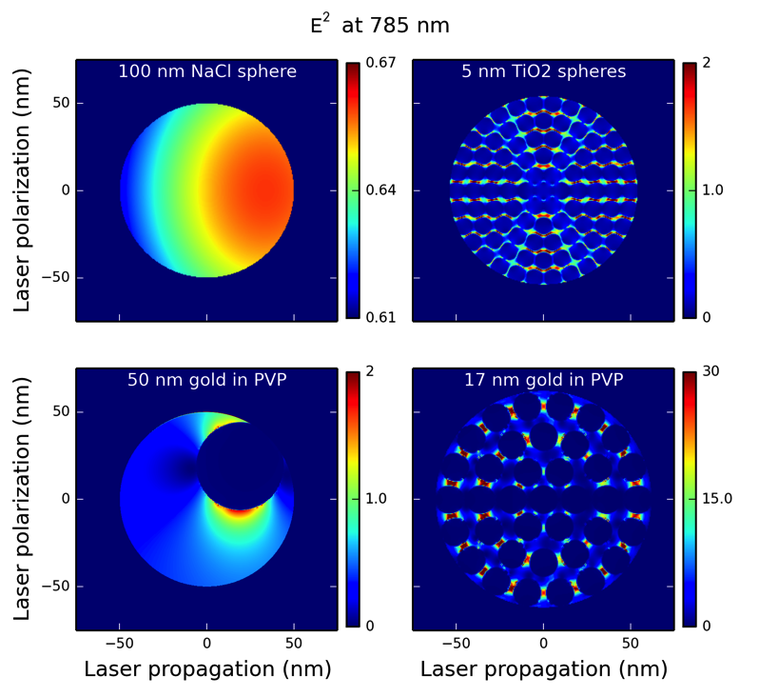
FDTD simulations
Explain light absorption
Notes:
Armed with this information about the morphology of the nanostructures, we used finite-difference time-domain simulations to explain the light absorption behavior of the nanoparticles. These simulations can figure out how intense the light field will be in each of these particles. In all cases, the nanoparticle can enhance the laser field.
In each case, the location of the strongest electric field agrees with the experimentally observed direction of ion ejection. A) for NaCl, the light is enhanced on the backside of the particle, and it seems that the particle is basically acting like a lens and focusing the light onto itself. B) For the TiO2 aggregates, the light is enhanced between the TiO2 particles, but there is not preference for the forward or backward direction. C) For the 50 nm gold nanoparticles, there is not a big effect from the laser polarization or propagation. The electric field is simply strongest near the gold nanoparticle and so a plasma will be formed in this region of the particle preferentially. D) For the 17 nm gold nanoparticles, the field is enhanced by an order of magnitude between the gold nanoparticles. If you look very closely, you can see that the field is higher here on the front side of the particle, in agreement with the experimental results.

Slide 39
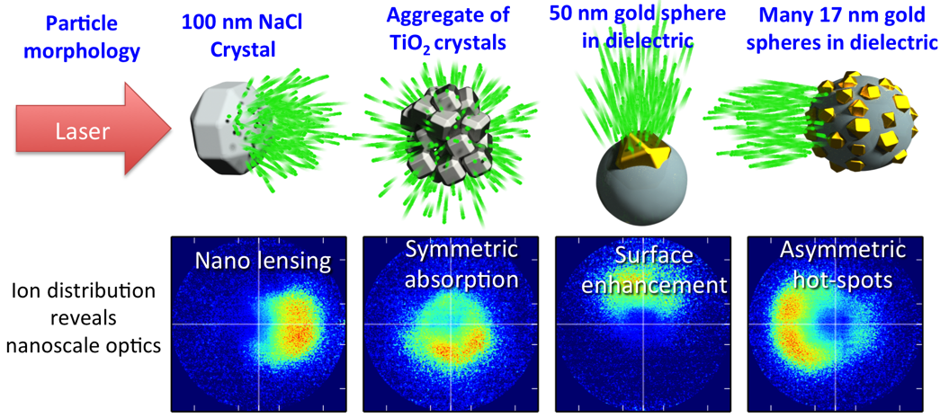
Summary
Ion angular distributions reveal nanoscale optics
Notes:
To summarize this section, we have observed very different ion ejection from these four different nanoparticle samples, and we have explained how the direction of ion ejection is representative of the nano-optical effects in the particles. This is, to our knowledge, the first example where we can measure the directional absorption of strong femtosecond laser pulses at a high repetition rate.

Slide 40
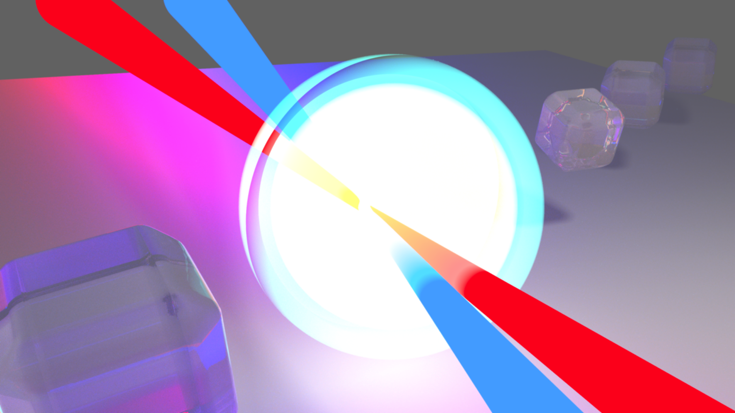
Study 3 - Nanoplasma Controlling shock waves in nanoplasmas
D. D. Hickstein, F. Dollar, J. A. Gaffney, M. E. Foord, G. M. Petrov, B. B. Palm, K. E. Keister, J. L. Ellis, C. Ding, S. B. Libby, J. L. Jimenez, H. C. Kapteyn, M. M. Murnane, and W. Xiong, “Observation and Control of Shock Waves in Individual Nanoplasmas”
Phys. Rev. Lett. 112, 115004 (2014).
Notes:
Now I will move on to the third study, where we used two time-delayed laser pulses to observe and control shock wave formation in nanoplasmas. This was published in physical review letters in 2014.

Slide 41
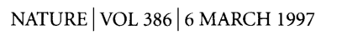
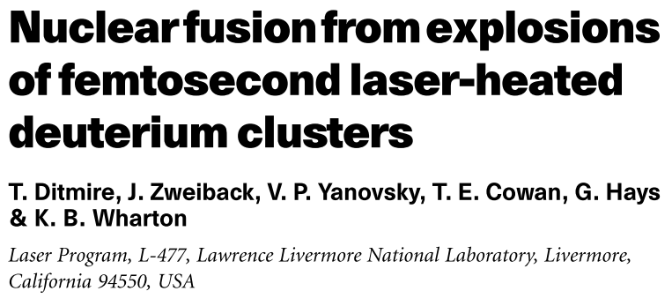
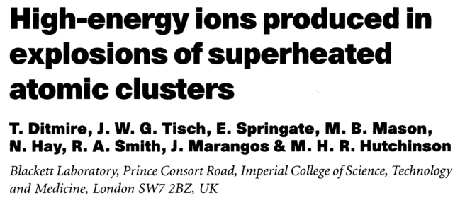
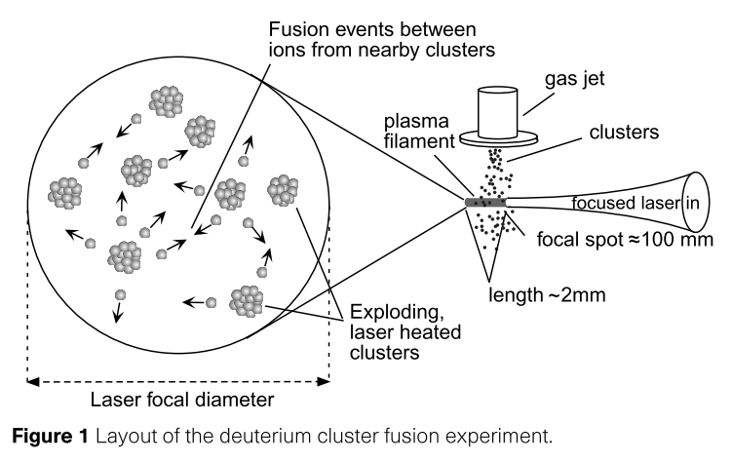
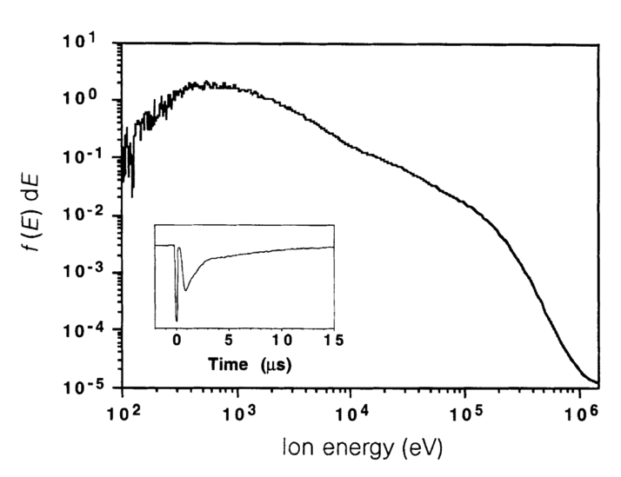
Motivation: nanoplasmas
Great light absorbers
2x10¹⁶ W/cm²
2x10¹⁶ W/cm²
Notes:
In the process of trying to image the electronic structure of nanomaterials, we realized that VMI is also an excellent way to investigate a much higher intensity regime, where nanoparticles are rapidly converted into nanoplasmas.
I think that the word “nanopalsma” is really cool. But, if that is not enough to get you excited, let me get you interested by saying that nanoplasmas have an unusual ability to absorb large amounts of laser energy into a small volume, and, in-so-doing, produce very high energy physics with table-top scale lasers. For example, I show two articles here, one where nanoplasmas were used to generate ions up to 1 Mega-electron-volt, and another where nanoplasmas were used to achieve nuclear fusion. Both of these studies were completed at intensities accessible to current tabletop scale lasers.

Slide 42
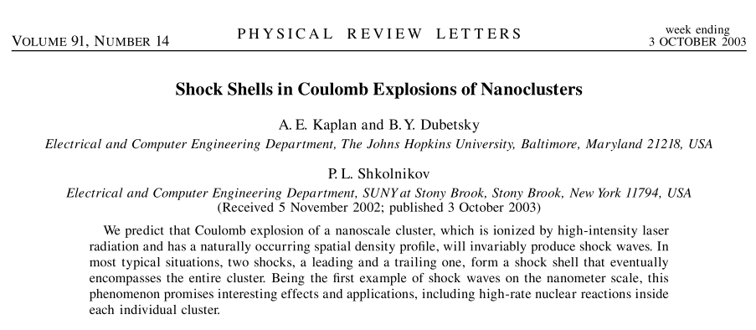
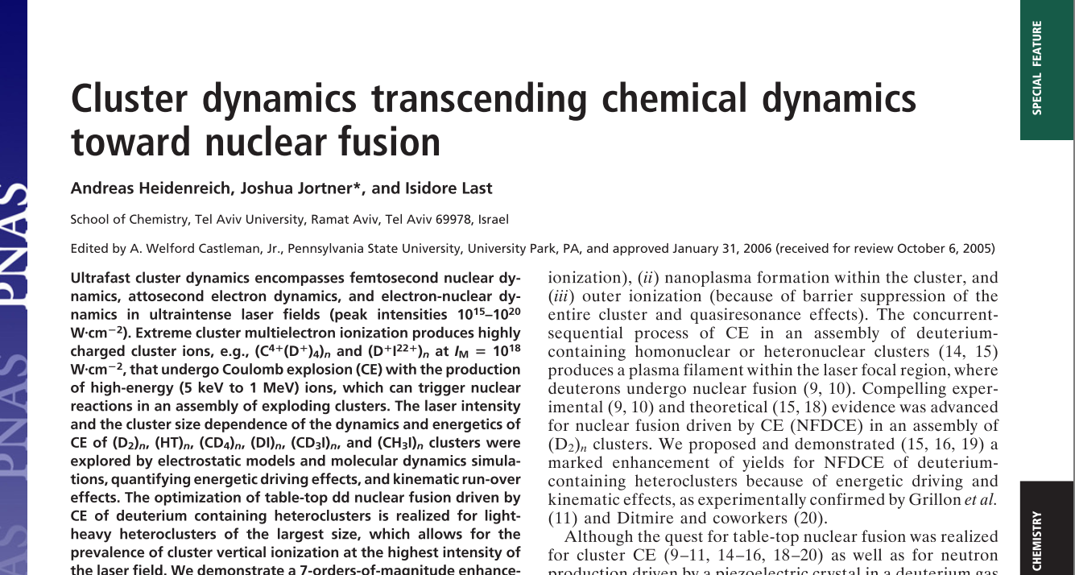
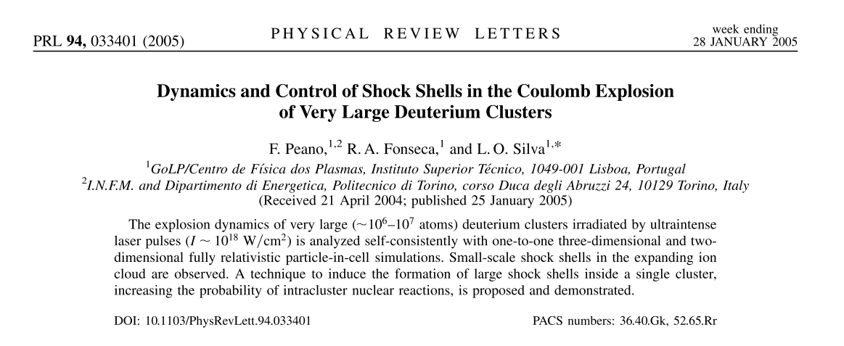
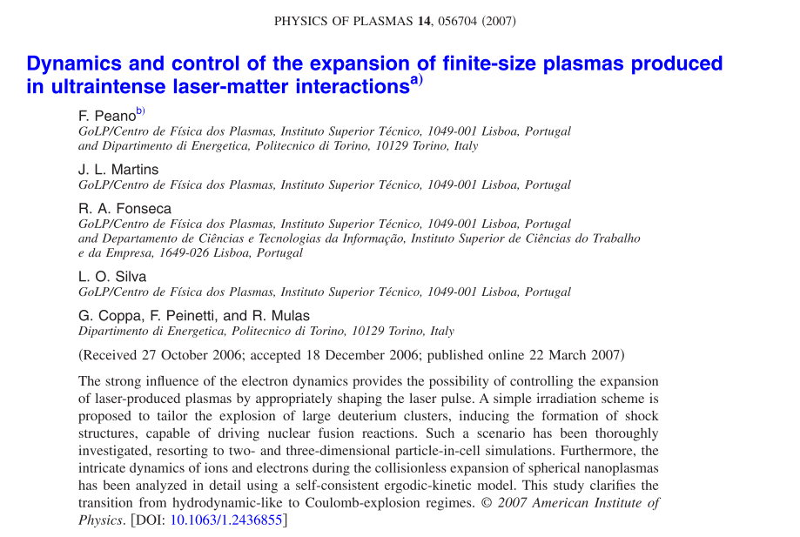



Prediction of nanoplasma shock waves
Notes:
We made this observation of shock waves in nanoplasmas more or less by accident, but actually, shock waves in nanoplasmas had been predicted over a decade ago. First Kaplan and co-workers wrote this paper, and then a lot more followed. All of these papers were very excited with the idea that driving shock waves through nanoplasmas could be a way to make a very compact particle accelerator. After a while, with no experimental confirmation, they got bored and the papers stopped.
So, we hope that by making the first observation of shock waves in nanoplasma, we have opened a new avenue of research, but at the end of the day, we are can at least rest assured that we have brought some glimmer of joy to the theorists by confirming their predictions.

Slide 43
Single laser pulse
Laser polarization
Laser propagation
Notes:
When we use just one laser pulse to form nanoplasmas, we see photoion angular distributions that look like this. Just big, broad features.

Slide 44

Two pulses
Laser polarization
Laser propagation
Notes:
However, when we use two laser pulses and we set the time-delay to about 10 picoseconds, we see these beautiful shells. As you can guess, these are the shock waves. But, let me tell you how we figured out that is what they were.

Slide 45




Time dependence
Notes:
So, we looked at how the total photoion yield changed as a function of the time-delay between a 400 nm and an 800 nm laser pulse. By using an 800 and 400 nm laser pulses, we are able to create a large enhancement in the total photoion yield then the 400 nm pulse precedes the 800 nm pulse by about 2 to 30 femtoseconds.
This effect has been seen before in nanoscale silver clusters and it was explained very simply. The first pulse creates a nanoplasma which expands. As the nanoplasma expands, it becomes more larger therefore more absorbing of the second laser pulse. However, as the nanoplasma becomes too large, it’s density drops below the critical density and it can no longer effectively absorb energy from the laser pulse.
So, this is a nice result, but we see something even more interesting if we look at the photoion angular distributions that correspond to these red dots.

Slide 46

Time dependence
Notes:
So, we looked at how the total photoion yield changed as a function of the time-delay between a 400 nm and an 800 nm laser pulse. By using an 800 and 400 nm laser pulses, we are able to create a large enhancement in the total photoion yield then the 400 nm pulse precedes the 800 nm pulse by about 2 to 30 femtoseconds.
This effect has been seen before in nanoscale silver clusters and it was explained very simply. The first pulse creates a nanoplasma which expands. As the nanoplasma expands, it becomes more larger therefore more absorbing of the second laser pulse. However, as the nanoplasma becomes too large, it’s density drops below the critical density and it can no longer effectively absorb energy from the laser pulse.
So, this is a nice result, but we see something even more interesting if we look at the photoion angular distributions that correspond to these red dots.
The red dots indicate which frames contain these sharp rings. So, we see that the appearance and disappearance of the rings corresponds very closely to the peak in the ion yield. This indicates that the shock waves are also linked to the expansion of the nanoplasma. This is exactly the behavior predicted by the theory papers. Several of them explicitly mentioned that using a first laser pulse to pre-expand the plasma and having a second pulse generate the shock wave would be the ideal situation for creating strong shock waves in nanoplasmas.

Slide 47

Hydrodynamic simulations
Calculations by Jim Gaffney, LLNL
Notes:
This explanation is confirmed with hydrodynamic simulations completed by our collaborators at Lawrence Livermore National Lab. This plot has some fun colors, but it’s not a cartoon, it’s the actual results from the numerical simulations.
The first three frames plot the density of the plasma versus the radial coordinate. Immediately after the first laser pulse, the plasma density is just a step function corresponding to the solid density nanoparticle. After about 20 picoseconds, the plasma has expanded and now assumes this smooth decay into the vacuum. Because of this decaying density profile, when the second laser pulse arrives, it is absorbed in a thin layer near the critical density. This localized absorption creates a pressure wave that propagates inwards. The pressure wave reflects from the center and moves outwards. As the pressure wave moves outwards. It steepens into a shock wave. The shock wave may look pretty puny when plotted in the density distribution, but when we look at the kinetic energy distribution of the ions, which is what we actually see on the detector, then the shock wave manifests as an obvious sharp peak, in good agreement with the experiment.

Slide 48
First observation of shock waves in single nanoplasma
Notes:
And so, using this apparatus that can look at individual nanoparticles in femtosecond laser fields, we can make the first observations of shock waves in nanoplasmas. And looking at individual particles is very important, because the shock depends on the exact laser intensity and particle size, so if we tried to look at many nanoplasmas at once, we would have missed these shock waves.

Slide 49
Outline
Motivation
Why femtosecond lasers?
Why atoms, nanoparticles, and nanoplasmas?
Why photoelectron/photoion spectroscopy?
Studies
Atoms
Nanoparticles
Nanoplasmas
Future directions
Notes:
Now, I have presented all of the research that is included in the thesis, but I wanted to give you a little preview of what we are currently working on and plan to work on in the future.

Slide 50
Future directions
Two-color circular fields
Attosecond Pulses
and Ultrapure Nanoparticles

Slide 51

Atoms in circularly polarized fields
(Chris Mancuso)
Notes:
Recently, Chris Mancuso has completed another study of strong field ionization in atoms, but this time, instead of working with linearly polarized light, he used two circularly polarized laser fields of different colors. What we found is that we can generate the same kind of low-energy rescattering structures even with these very complicated fields. This experiment really expands the parameter space compared to the study that I presented at the start of this talk. Now, instead of the electrons being driven in a line, up and down by the laser field, they can be driven anywhere in a two-dimensional plane. So, this might open a lot more doors for more complicated experiments that use this rescattering process to provide information about molecular structure.

Slide 52



Time resolved XUV experiment on nanoparticles
(Jennifer Ellis)
100 nm diameter droplets of Oleylamine
Cooling of hot
electrons
Raw data
22 eV first
800 first
Notes:
We are also pushing towards new frontiers with nanomaterials as well. While I was writing my thesis and working on this talk, Jennifer Ellis was in the lab for three weeks straight building the apparatus to collect. The first time-revolved data on nanoparticles high-harmonic generation. And I don’t mean first at JILA, I think that this experiment is one-of-a-kind in the world. Anyway, we have the first time-resolved data corresponding to the heating of electrons in a sample of oleylamine. Here we can see the electrons cooling on a timescale of about 300 fs.

Slide 53

Magnetron nanoparticle source
Notes:
The next step that we are going to take is to switch to generating our nanoparticles through a magnetron sputtering source, which will allow us to generate ultrapure, very small nanoparticles of metal and semi-conductor materials.

Slide 54



Attosecond studies of pure, isolated nanoparticles
Attosecond pulses
Plasmon dynamics in metal nanoparticles
Exciton dynamics in Quantum Dots
Notes:
The combination of the HHG source and the magnetron nanoparticle source will allow us to utilize the attosecond pulse trains that are created with HHG to study the femtosecond and attosecond dynamics of nanoparticles. Studying things rangingfrom the incredibly fast plasmon dynamics in metal nanoparticles, to exciton dynamics in quantum dots.

Slide 55

Conclusions and outlook
Results
First observation of “inner spider” structures
First use “plasma explosion imaging”
First observation of shock waves in nanoplasmas
Future directions
Attosecond dynamics of nanomaterials

Slide 56











Collaborators
JILA – CU Physics
University of Colorado Chemistry Department
Brett Palm
Jose Jimenez
Dan
Hickstein
Ellen
Keister
Franklin Dollar
Jennifer
Ellis
Wei
Xiong
Gordana
Dukovic
Kyle
Schnitzenbaumer
Molly Wilker
Lawrence Livermore National Lab
Naval Research Lab
Henry Kapteyn
Margaret Murnane
Jim Gaffney
Steve Libby
George Petrov
Notes:
To complete these experiments, we needed help from a lot of different, and here is just a partial list of people that I need to thank. Thanks to the team at JILA, especially Jennifer Ellis and Wei Xiong and MARGARET and HENRY. Also thanks to Jose Jimenez and his graduate student Brett Palm. And big thanks to our theory collaborators at Livermore National Lab and Naval Research Lab.

Slide 57
Acknowledgements
Mary Musselman
Dennis Hickstein
Matt Musselman
Laura Johnson
Margaret Murnane
Henry Kapteyn
Predrag Ranitovic
Xibin Zhou
Robynne Lock
Wei “Golden Bear” Xiong
Curtis Stevens
Katie Johnson
Jennifer Ellis
F. Dollar
Chengyuan Ding
Paul Arpin
Matt Seaberg
Dan “Classical” Adams
Tenio “Pops” Popmintchev
Tory “UltraTorr” Carr
Craig “America” Hogle
Ellen “Yellen” Keister
Chris Mancuso
Bosheng Zhang
Tingting Fan
Ming-Chang Chen
Bill Peters
Patrik Grychtol
Michael Gerrity
Wen Li
Chan La-o-vorakiat
Stefan Witte
Stefan Mathias
Hans Green
David Alchenberger
Blaine Horner
Kim Hagen
Ariel Paul
Todd Asnicar
Kels Detra
J. R. Raith
Brad Baxley
Kyle Schnitzenbaumer
Molly Wilker
Gordana Dukovic
Brett Palm
Jose Jimenez
Pedro Campuzano–Jost
Jim Gaffney
Mark Foord
Steve Libby
Ymkje Huismans
Marc Vrakking
Xiao-Min Tong
Ofer Kfir
Oren Cohen
Avner Fleischer
Luis Miaja-Avila
Carlos Hernandez-Garcia Andreas Becker
George Petrov
Mikhail Ryazanov
Hanna Reisler
Robbie Wright
Jennifer Li
Ethan Scott
Maithreyi Gopalakrishnan
Leigh Martin
Xiaoshi Zhang
Mike Walls
Daisy Raymondson
Neil Anderson
Sterling Backus
David Jonas
Agnieszka Jaron-Becker
Ralph Jimenez
W. Carl Lineberger
Jason Haas
Hillary Smith
Julie “Red pencil” Phillips

Slide 58

Thank you!
Notes:
So, thank you for your attention, and I would be glad to take any questions or comments.

Slide 59
Thank you!
Notes:
So, thank you for your attention, and I would be glad to take any questions or comments.

Slide 60
Thank you!
Notes:
So, thank you for your attention, and I would be glad to take any questions or comments.

Slide 61
Supplemental Slides

Slide 62
Supplemental Slides

Slide 63
HHG
Supplemental slides

Slide 64

HHG

Slide 65


Three-step model
Notes:
Pinnick and whitesands 1980s

Slide 66
Three-step model
STEP 1 STEP 2 STEP 3

Slide 67


Strong-field ionization of xenon
Supplemental slides

Slide 68
TDSE simulations
Notes:
And we know that these results are not just some artifact due to our spectrometer, because our collaborator in Japan has calculated the theoretical photoelectron angular distribution using a supercomputer and it agrees with what we recorded using our VMI spectrometer.

Slide 69
Inner spider cutoffs

Slide 70
Inner spider cutoffs

Slide 72
TDSE dependence on intensity

Slide 73
Plasma explosion imaging
Supplemental slides

Slide 74




Particle generation
Atomizer generates broad particle distribution centered around 100 nm diameter
Electrostatic classifier and DMA (Differential Mobility Analyzer) select particles of a specific size range.
Aerodynamic lens focuses particles into collimated beam
Notes:
We borrowed three pieces of equipment from the aerosol chemistry world. First, we used a compressed gas atomizer to convert a liquid sample (here in this jug) into a mist of droplets with a size distributions centered around 1 micron in diameter. These droplets then evaporate, leaving behind whatever material was dissolved in the solvent.
This electrostatic classifier passes the particles through a column, which can be used to select a specific size of particles. This causes a decrease in the particle density, so we typically did not use this for most of the experiments that I will present today. The particle aerosol then passes through an aerodynamic lens, which is basically a tube full of washers that are carefully calculated to cause the nanoparticles to emerge as a collimated beam while leaving the gas divergent.

Slide 75

PEI Electrons

Slide 76

PEI Centers of mass

Slide 77
Single KI nanoparticle Mass Spectrum

Slide 78

Supplemental Slides
Observing the electron wavefunction in quantum dots
Notes:
Now we talk about the third study that we completed using this apparatus. This study is more in line with the original motivation for building the apparatus in the first place, which is observing the electronic exciton wavefunctions in quantum dots.

Slide 79

Quantum dots
Semiconductor nanocrystals

Slide 80

Experiment
Two-pulses

Slide 81

Photoelectron yield depends on size

Slide 82

Evanescent exciton

Slide 83


Observing charge transfer

Slide 84
Conclusions
Experiment
VMI is a versatile tool for nanoscience
Results
Revealed nanoscale optics with localized plasma
First observation of shock waves in nanoplasmas
Ultrafast charge transfer in quantum dots
Future directions
Use high-harmonic generation (HHG) source
Generate isolated ~5 nm nanoparticles
Notes:
To conclude the talk, I will emphasize just a few key points. Mainly, what I wanted to show is that, when you combine it with a nanoparticle source, the velocity map imaging spectrometer can be a versatile tool for investigating nanoscale systems. I showed you a few results to support this, demonstrating how we have used a VMI to make the first observation of shock waves in nanoplasmas, reveal nanoscale optical effects via the formation of a localized plasma, and (if you saw the poser on Monday) ultrafast charge transfer between quantum dots and an organic dye molecule.
In the future, we are still venturing onwards on our quest to image the excitonic orbitals of quantum dots, and we hope to achieve this goal incorporating a high-harmonic source into the experiment and improving our particle source to generate smaller and higher-quality nanoparticles.

Slide 85
Nanoplasma shock waves
Supplemental slides

Slide 86
Observation of shock waves
Notes:
This is what the data looks like. If you use a single laser pulse, you generate a big, mostly featureless, blob of ions, shown here. The features that you do see here are due to damage of our MCP detector, so the actual photoion distribution is even more boring.
If we use two laser pulses, we usually still see a big blob of ions. However, if we use two laser pulses with a time delay of about 7 to 40 ps, we start to see some ions distributions that have a sharp peak, that I am going to explain is a shock wave.

Slide 87


1. Observation of shock waves
One pulse
Two pulses
Notes:
The above are the raw photoion momentum distributions from nanoplasma explosions of single nanoparticles with diameters between ~40 nm and 100 nm with an 800 nm laser. The center of the frame corresponds to ions with zero kinetic energy while the edge of the frame is 80 eV. The laser polarization is in the vertical direction and the laser propagates from left to right. Frames a and f show no particles, while frames b, d, h, I, and j show diffuse plasma explosions. Frames c, e, and g, display shock shells¹ (indicated with arrows) that were generated from particles subjected to the precise laser intensity required to initiate the shock physics. ¹Kaplan, Dubetsky, Shkolnikov, Phys. Rev. Lett. 91, 143401 (2003)

Slide 88
One pulse animation
Notes:
But occasionally we see a flash corresponding to the ions created from a single laser-irradiated nanoparticle. The edge of the frame is about 100 eV, so as you can see, we are producing a big blob of ions all the way past 100 eV.

Slide 89
Two-pulse animation

Slide 90



Time dependence of shock waves
40 ps
10 ps
Notes:
One last point that I would like to make is this. The shock waves look qualitatively different at different time delays. As you can see, the shock at 10 ps looks much less sharp than the shock at 40 ps. If you look at the 1D lineouts, you can see that the shock at 40 ps is indeed much sharper and contains a larger fraction of the ions than the shock at 10 ps. This same effect is seen in the simulations. So, this demonstrates that we have some rudimentary level of control over the shock waves. In the future, we think that it could be possible to use additional laser pulses to shape the plasma density profile to further enhance the shock wave formation.

Slide 91




Shock waves with two pulses
2. Plasma slowly expands, assuming the smooth density profile crucial for shock production
1. Pump pulse turns nanoparticle into plasma
3. Pump pulse rapidly explodes the plasma
4. Shock shell forms in rapidly expanding plasma
Density profile
Density profile
Density profile
Density profile
Time (picosecond timescale)
Notes:
This allows us to make the following qualitative picture of what is going on. The first pulse creates a plasma. This plasma then expands. The amount of expansion depends on the time delay before the second laser pulse. When the second laser pulse arrives and dumps more energy into the plasma. Then, a shock forms in the expanding plasma.

Slide 92





Size selected nanoparticles
60 nm
80 nm
100 nm
120 nm
140 nm*
*Recorded with lower MCP setting

Slide 93

Size selected nanoparticles

Slide 94
Comparison to previous experiments
Experimental parameter | Previous experiments | This experiment
Particle composition | Condensed gases (Xe, Ar, D₂) | Solids (NaCl, NH₄NO₃, gold)
Nanoplasma diameter | 5 nm | 100 nm
Number of atoms | 10³ to 10⁴ | 10⁷
Plasma temperature | keV | eV
Expansion timescale | 10⁻¹⁴ sec | 10⁻¹¹ sec
Nanoplasmas per laser pulse | >10⁴ | <1
Notes:
So, how did we observe shock waves in nanoplasma when so many other experiments had failed to do so? Well, we cheated!
The theory papers had predicted shock waves in the regime of small noble-gas clusters. Our experiment operates in a completely different regime, where we use much larger solid nanoparticles that contain several orders of magnitude more atoms. Most importantly, we look at just one nanoparticle per laser shot. Because our nanoparticles are so much larger than previous studies, we can collect enough ions even from a single nanoparticle.
So, how does the experiment work?

Slide 95
Nanoparticle + XUV
Supplemental slides

Slide 96

Magnetron nanoparticle source

Slide 97
First XUV on nanoparticles
Oleylamine

Slide 98
XUV Photoelectron yields

Slide 99
Introductory material
Supplemental slides

Slide 100




Kapteyn–Murnane Company Research Group
Notes:
Now that you have some idea about ultrafast lasers, let me tell you a little bit about who I work for. I work for two professors in the CU physics department named Henry Kapteyn and Margaret Murnane. And they run two things. First, they run a 30 person company located in east Boulder, near 55th and Arapahoe, that makes some of the best femtosecond laser systems in the world. Second, they run a 25 person research group in the JILA building that uses these femtosecond lasers to make attosecond pulses of extreme ultraviolet light and finds applications for these light sources.

Slide 101








Laser pulses
Ti:sapphire laser (25 fs)
High harmonic generation (HHG)
(300 attoseconds)
Flashlamps
Picosecond lasers
Shortest pulse
(67 as)
10⁻³
10⁻⁶
10⁻⁹
10⁻¹²
10⁻¹⁵
10⁻¹⁸
10⁻²¹
millisecond
nanosecond
femtosecond
zeptosecond
microsecond
picosecond
attosecond

Slide 102
JILA

